Slide 1
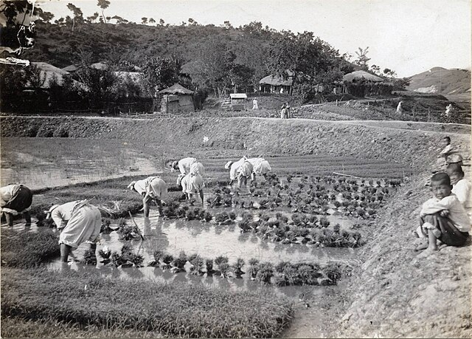
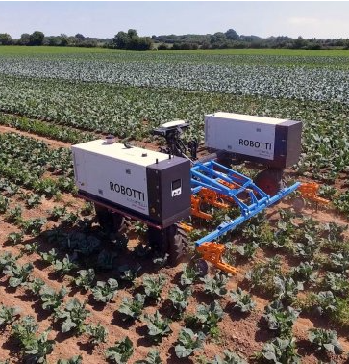
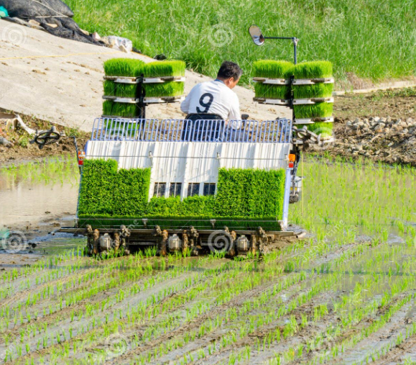
THE INFORMATION SYSTEM
Vision of NFA
DAVAO BRANCH
Korean’s industry-academia-government-research-mam development chain from poor country to a developed country in 70 years(core industry & Agricultural Information system )
2025. 11. 13. thur
BOHWAN SEO

Slide 2





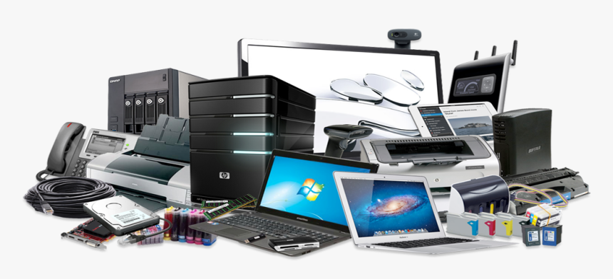

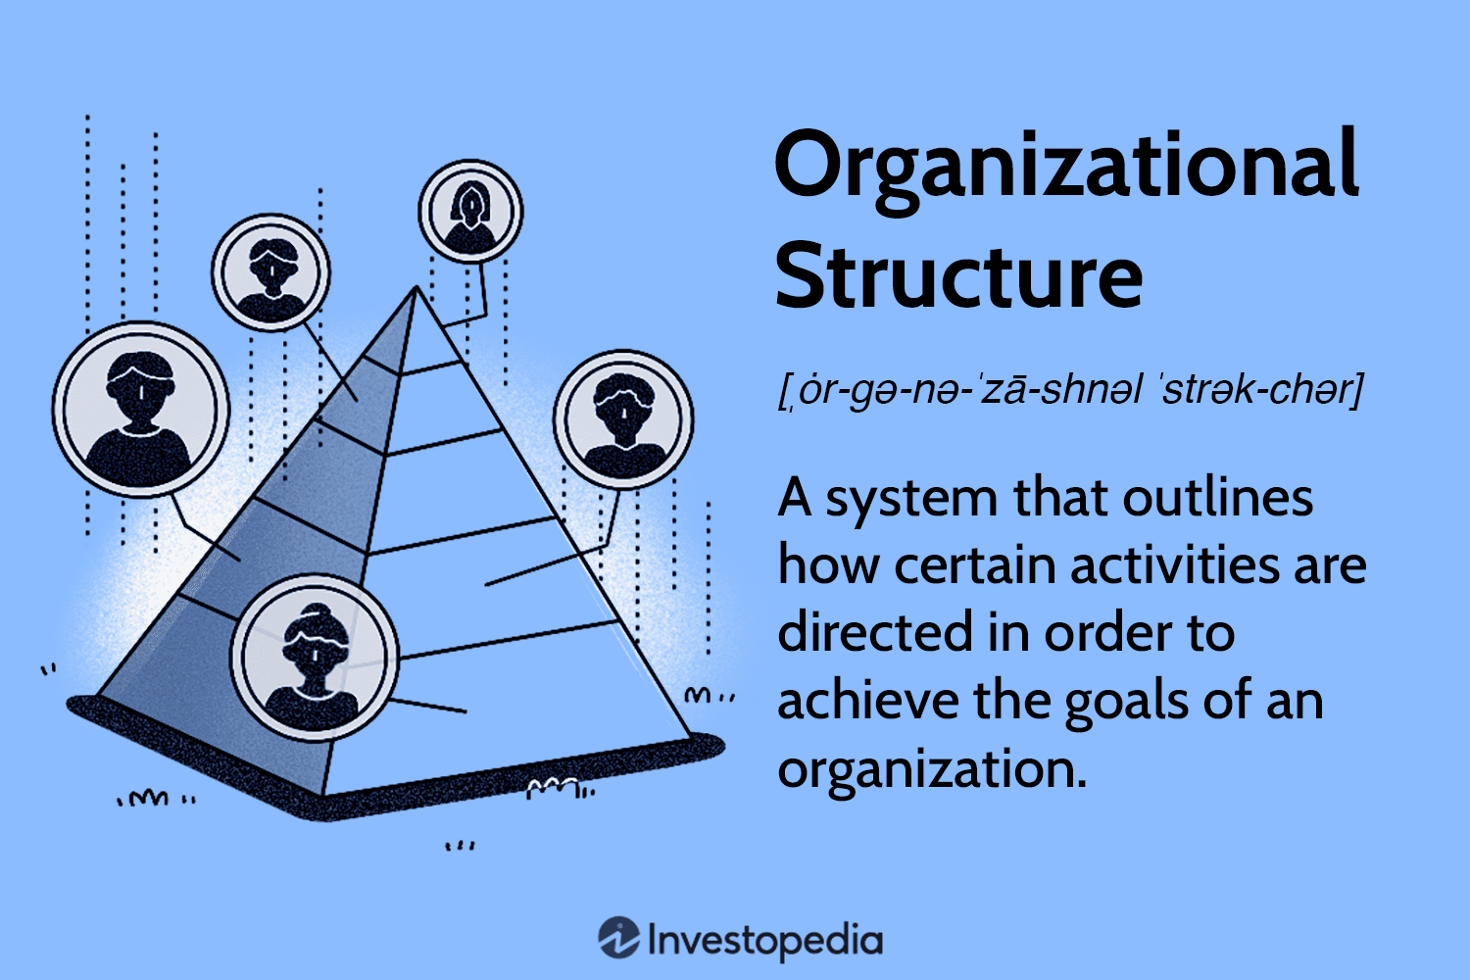



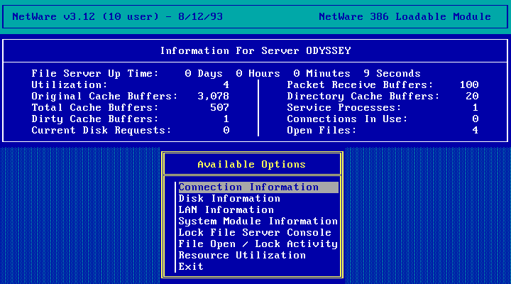
INFORMATION SYSTEM 6 COMPONENTS (1 Page brief material)
PEOPLEWARE - includes all the people involved in developing, operating, and using an information system.
HARDWARE - includes all the physical devices that support the operation of an information system..
SOFTWARE - is the set of programs and applications that tell hardware what to do and enable users to perform tasks in an information system.
ORGWARE - is the Organizational structure, policies, and processes that support the effective use of an information system, focusing on people and workflows rather than technology.
SYSTEM INTEGRATION
DATAWARE - refers to the data resources and structures used in an information system, including how data is stored, organized, managed, and retrieved.
NETWARE -is the set of hardware and software components that enable data communication and connectivity within and beyond an organization

Slide 3






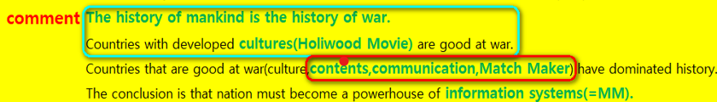
GOAL
WHAT IS INFORMATION
SYSTEM (IS)?
INFORMATION SYSTEM 6 COMPONENTS
A System in which IS 1.Component are 2.Organically Combined 3.to Respond in Unison to the Organizations Internal and External Environment 4.in Order to Achieve the Organizations Strategic Goal.
Internal Environment
SYSTEM INTEGRATION
External Environment

Slide 4
BY NOLAN MODEL – CONSULTING SUMMARY –
SELF DIAGNOSIS BY NOLAN MODEL REPORT
Self Diagnosis summary (diagnosis, problem)
Consulting recommendation (improvement plan)
Consulting Recommendation type
When to improve
Important or not
Nolan 4th stage (current stage)
Cooperation
1. Initialization
Enhance Staff Ability
(1) Improve and Implementing Document Mind-set
Essential
Short Term
Consultant (form discussion etc.)
2. Expand
Outsource only few
(2) Self-evacuation and Outsourcing Supervision
Discussion
Mid Term
3. Control
ICT(Convergence
Technology)
(3) Summary DB
Essential
Long Term
Consultant (Design Together)
Region, Stake Holder
Information Transfer Between Region and Stakeholders –in process
Suasion
Long Term
Central, distributed – self strategy (short- term, long term)
4. Maturity
What lessons should be learned from failure?
Expansion stage ->
What should be benchmarked?
Stages 2 to 3, 2010–2020 K-AMIS

Slide 5
Self-Assessment and Key Consulting Summary Table Based on KAIS Benchmarking Criteria
STAGE
SELF-ASSESSMENT SUMMARY
CONSULTING KEYWORD
STAGE-BASED ANALYSIS
1. Personal Internal
Development
Enhance Staff
Ability
1. Improve documentation capability
Outsourcing only few
2. The Korean audit of outsourcing
It seems like a situation moving from stage 1 to stage 2
2. Outsourcing
3. Management
ICT(Convergence Technology)
Immediate design and implementation needed
3.Summary DB(Jump)
4. System
Integration
Regional, Stakeholder
4. Benchmarking and Customization
Independent step-by-step parallel process needed
What lessons should be learned from failure?
Simplification of initial outsourcing management
Transparency
Technology management
Advancement of supervision (or auditing)
What should be benchmarked?
Laws, Regulations
Outsourcing
Auditing, Management
Dashboard, Mind etc.

Slide 6
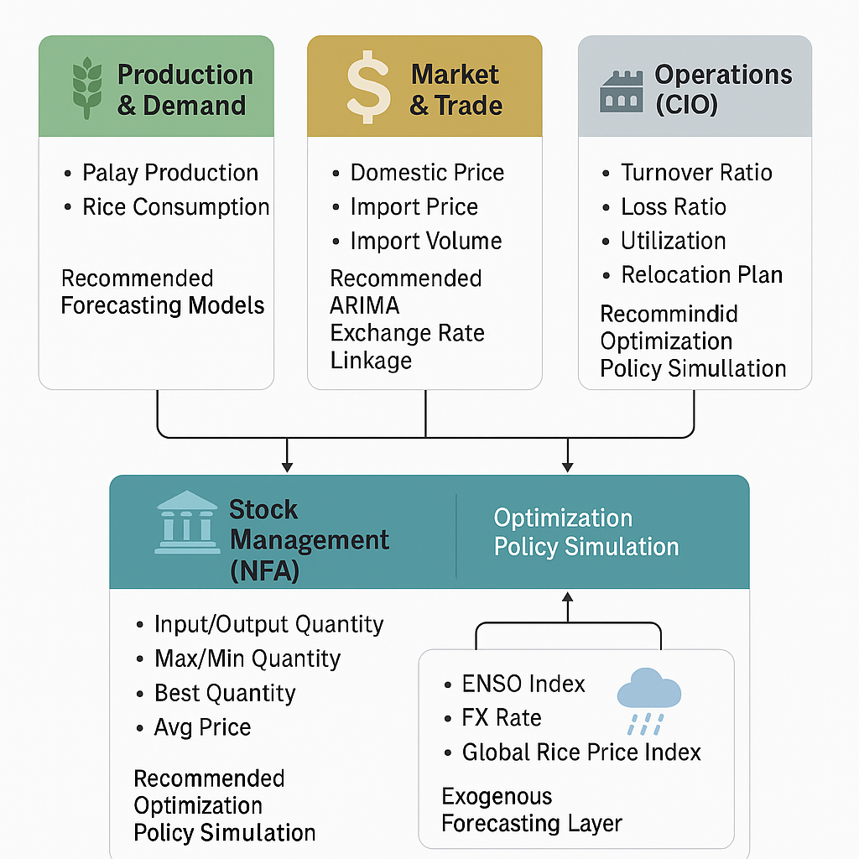
1. Recommended Dashboard Architecture

Slide 7
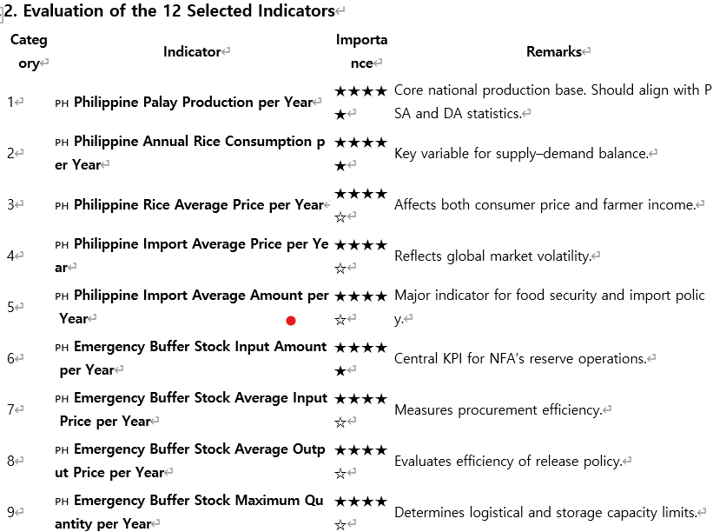

Slide 8
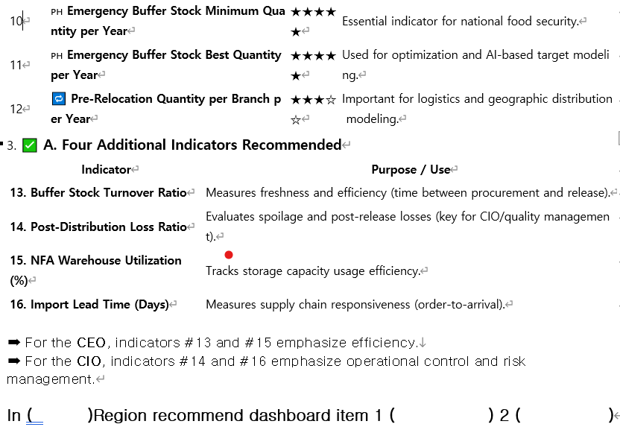

Slide 9
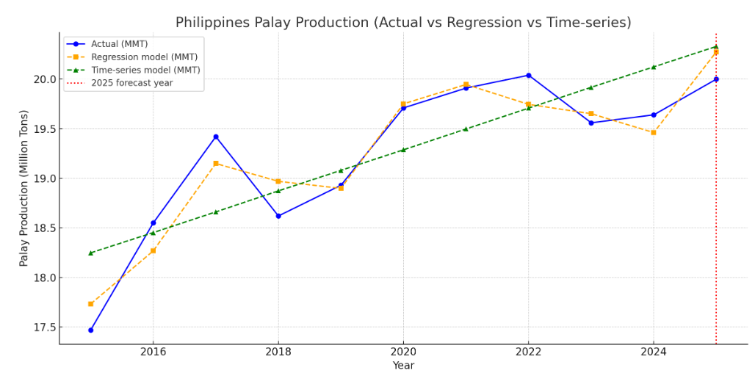

Slide 10
Palay Production (tons)=−28,885,900+
(−6,352.29)×Sunshine Hours+150.50×Rainfall (mm)+2,271,80×Average Temperature(C)+1,732.04×Typhoon–Earthquake Index
Explanation of Variables:
Palay Production (tons) → Dependent variable (target to be predicted).
Sunshine Hours → Annual total sunshine duration.
Rainfall (mm) → Annual precipitation.
Average Temperature (°C) → Mean annual temperature.
Typhoon–Earthquake Index → Combined disaster severity index (scaled 0–100).
🔵 Blue line (●) → Actual Palay Production (MMT)
🟠 Orange line (■) → Regression Model Prediction (MMT).
🟢 Green line (▲) → Time-Series (Holt–Winters) Model Prediction (MMT)
🔴 Red dashed line (│) → Forecast Year (2025)

Slide 11
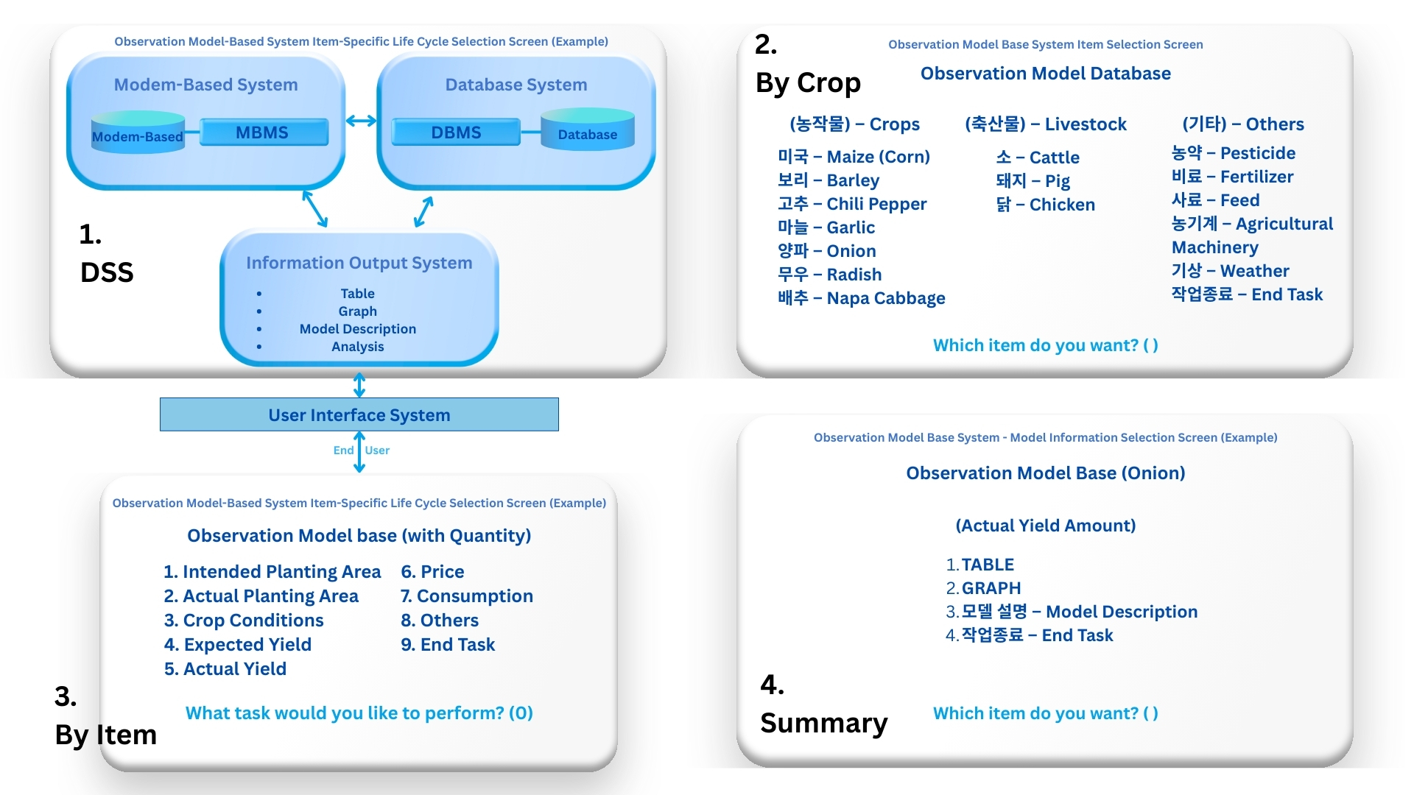
"Important Research and Development Cases Related to KAIS (Agricultural Decision Support System)"
What should be benchmarked?
- Daily routine daily report – Improving the level of the dashboard
Why was Samsung’s pig farming information system from 40 years ago world-class?
What should be accepted as a lesson from failure?
- Eliminating redundant research

Slide 12
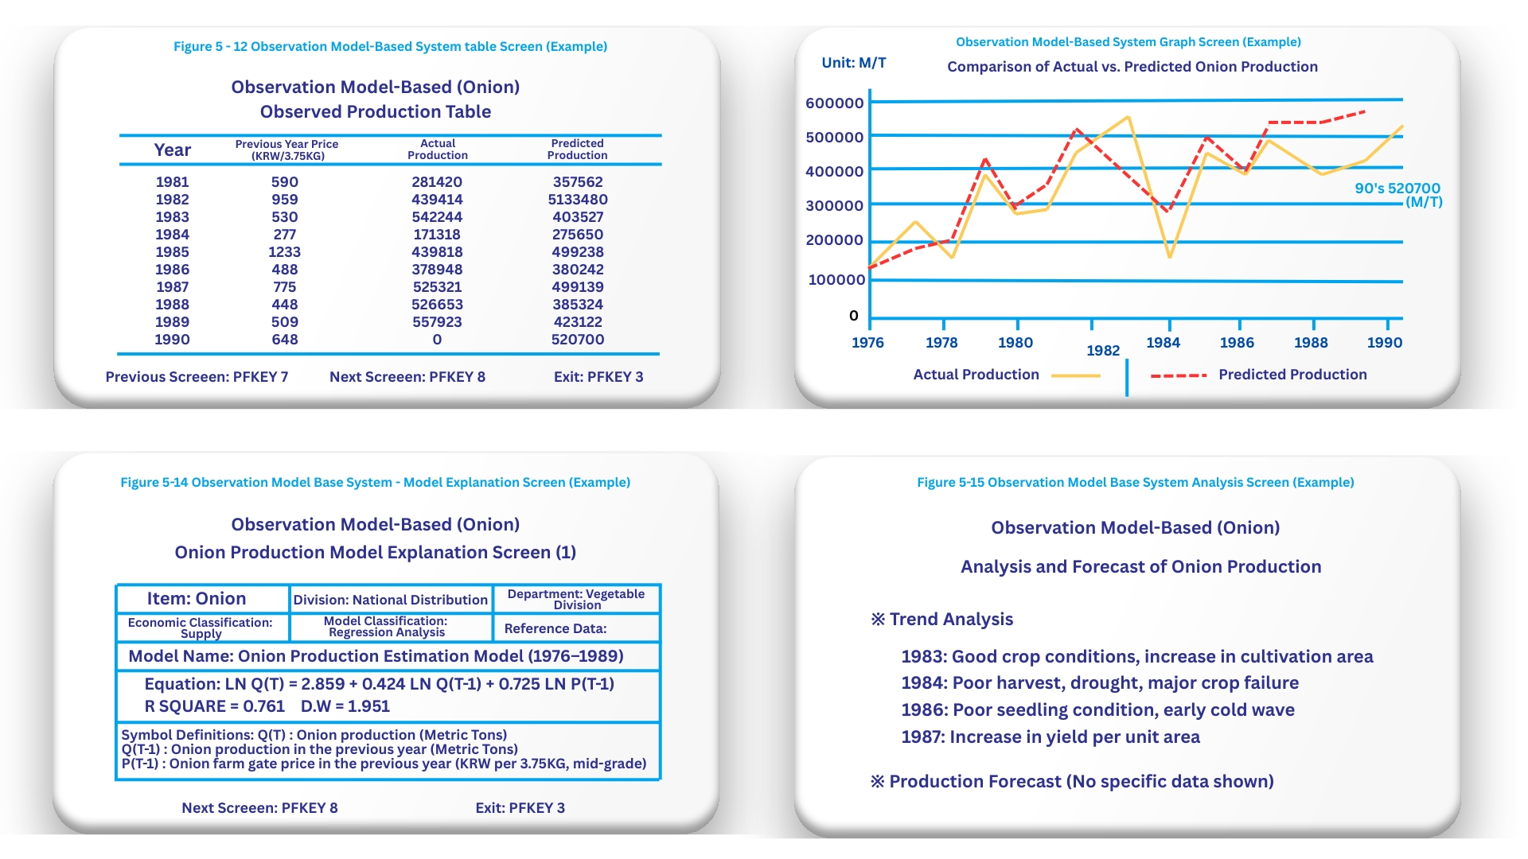
Important Research and Development Cases Related to KAIS (Agricultural Decision Support System)
What lessons will we take from failure?
Continuous management and maintenance of the system
Establishment of a dedicated team or appointing responsible personnel
What should we benchmark?
Early warning system(Dangerous Level)
Analysis reports on key decision-making points

Slide 13
One of the key issues of IS by Country
1
ONE OF THE KEY ISSUES OF IS BY COUNTRY
- The level of Information System Skill (Technology) in each Country is Mostly Similar
- The Difference is in the Information System
One of the key issues of IS by Country
CONSULTING TREND AND OUR DIRECTION
2
KOREA
PHILIPPINES
COMMENT
CONSULTING FOCUS
SKILL
(TECHNOLOGY)
High Group
High Group
Philippine is Better(IS English)
X(Up to staff)
Best Group
Best Group(comparing economy)
Korea is Better(IS Method,Mind)
0(Up to boss mind 1)
SYSTEM
One of the key issues of IS by Country
3
INFORMATION SYSTEM CRITICAL KEY POINT – CSF – Up to Boss
- How to Manage Information System (Skill (Techniques) -> System)
- How to Deal Data -> Information -> Knowledge
- How to Organize Them up to you(Peopleware)

Slide 14

1.Information system 6 component
2.Dashboard 2+2
3.Survey 7
Q & A 1. I-phone : NFS->AR
2. A : S->AR (Staff pride)

