Slide 1
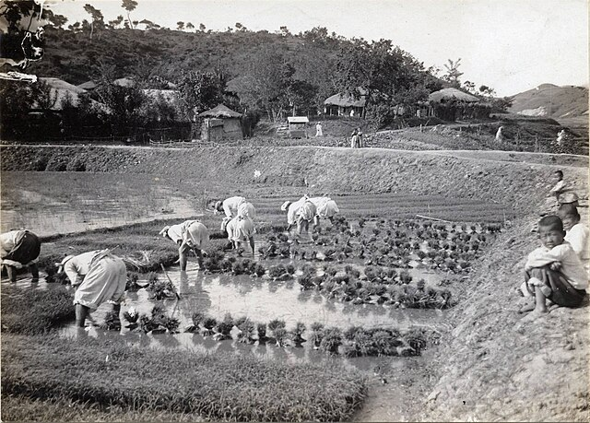
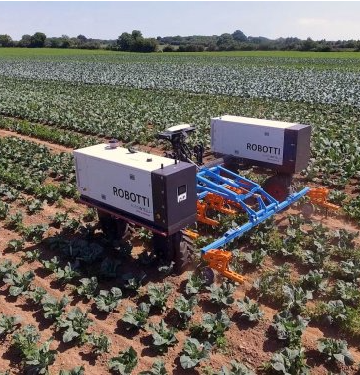
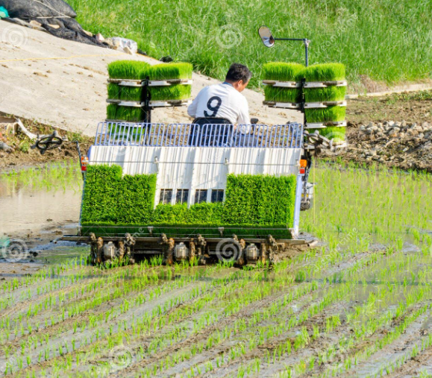
DEVELOPMENT STAGES
OF AGRICULTURE
INFORMATION SYSTEM
IN KOREA(H-K-AIS)
Korean’s industry-academia-government-research-mam development chain from poor country to a developed country in 70 years(core industry & Agricultural Information system )
2025. 6. 5
BOHWAN SEO

Slide 2
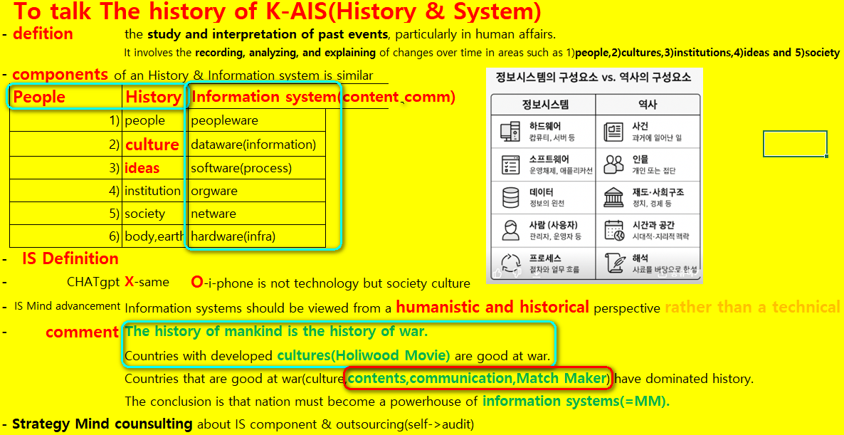
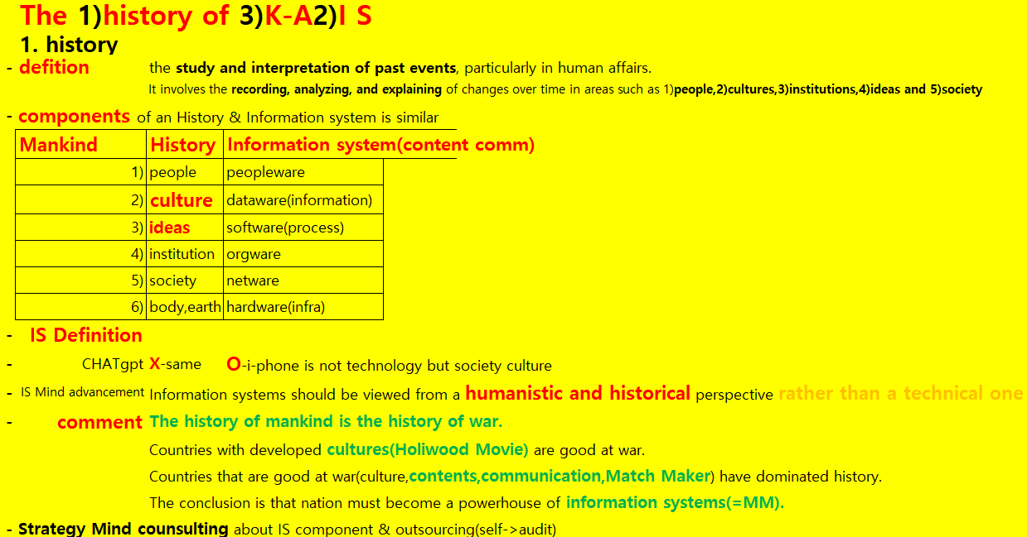

Slide 3
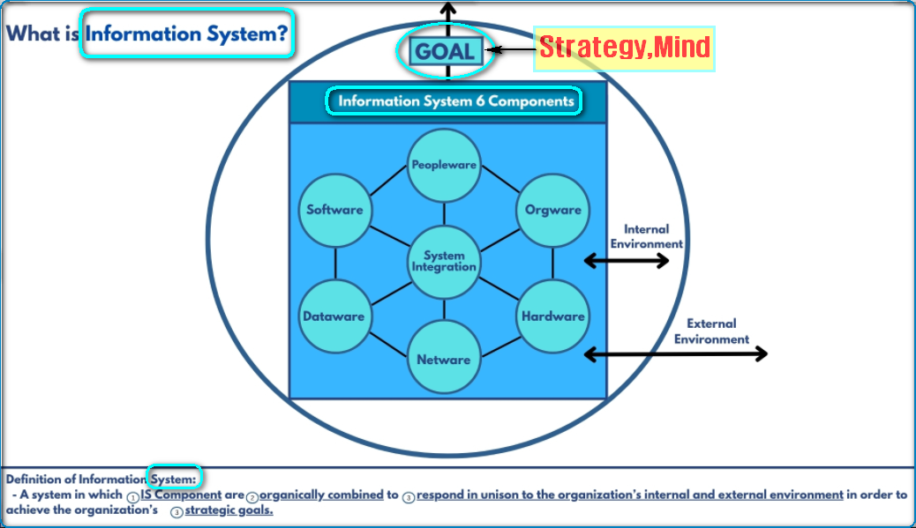

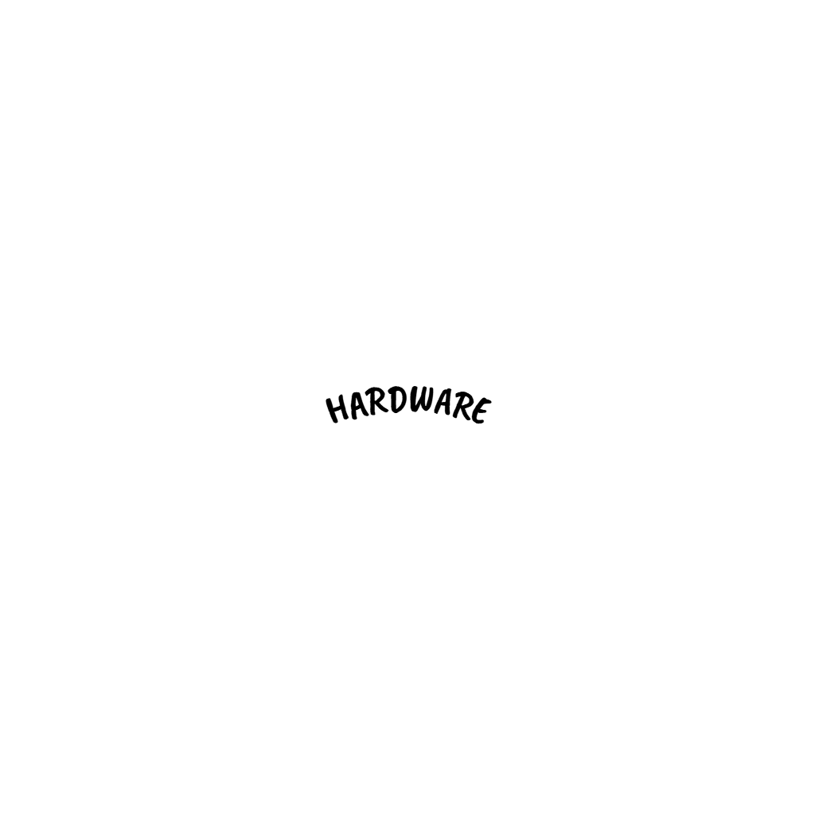

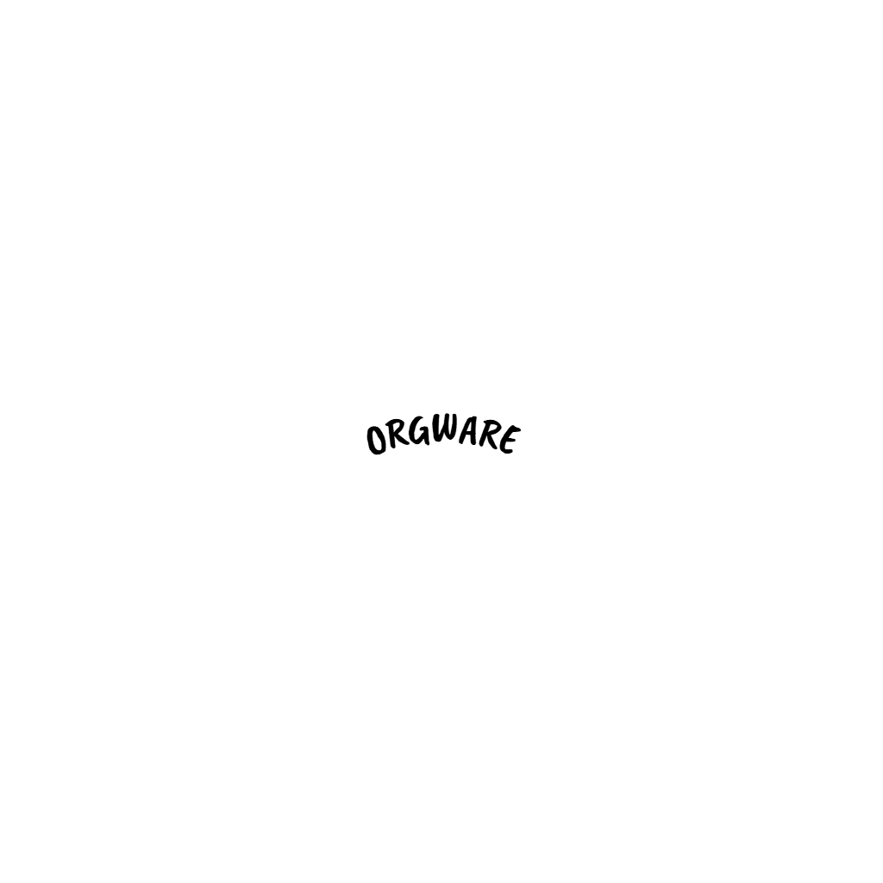
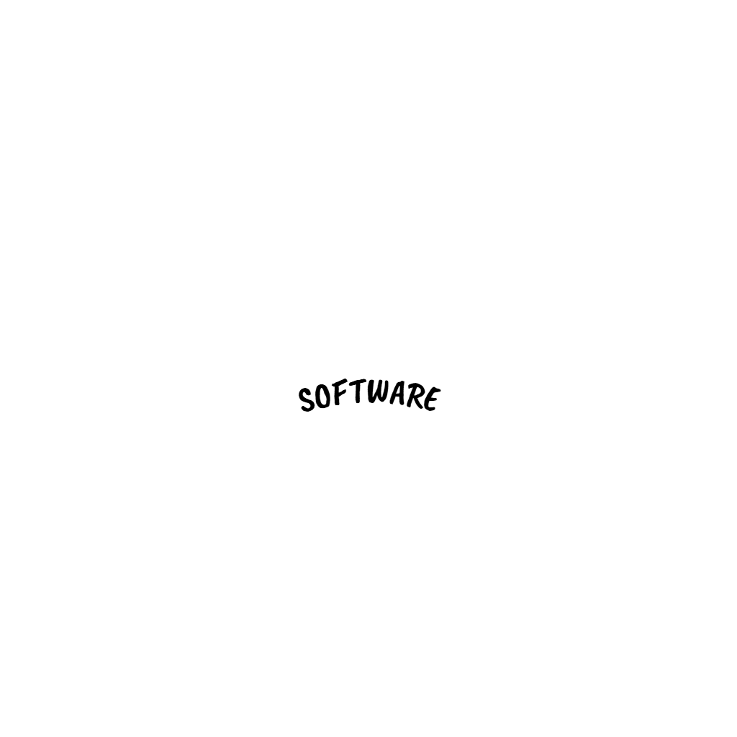
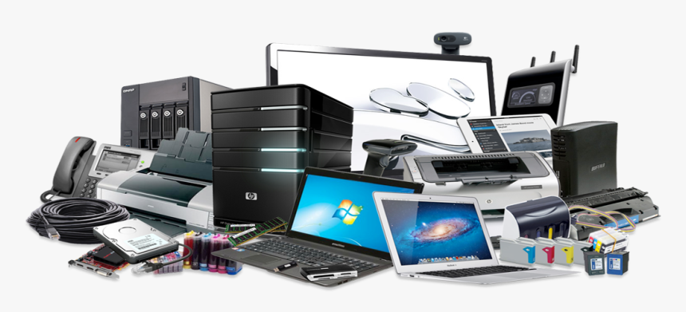

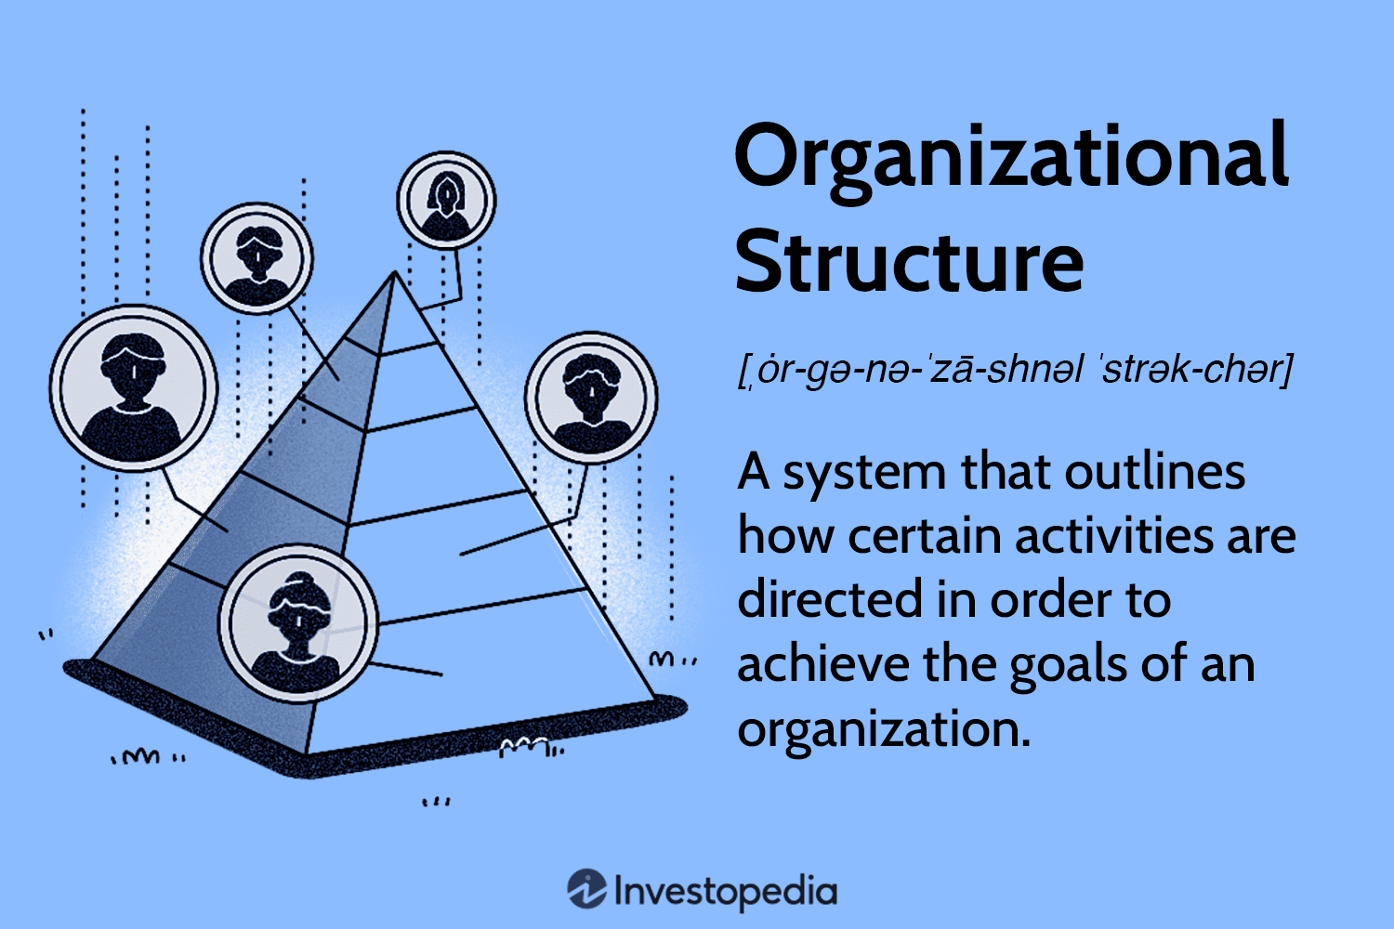
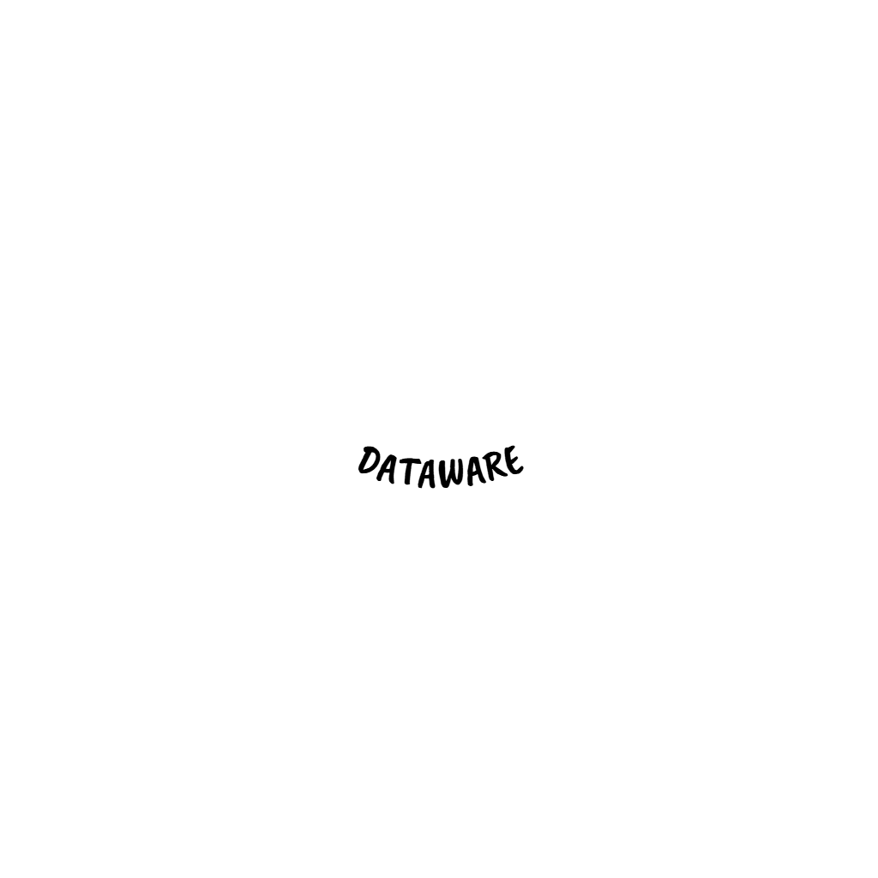
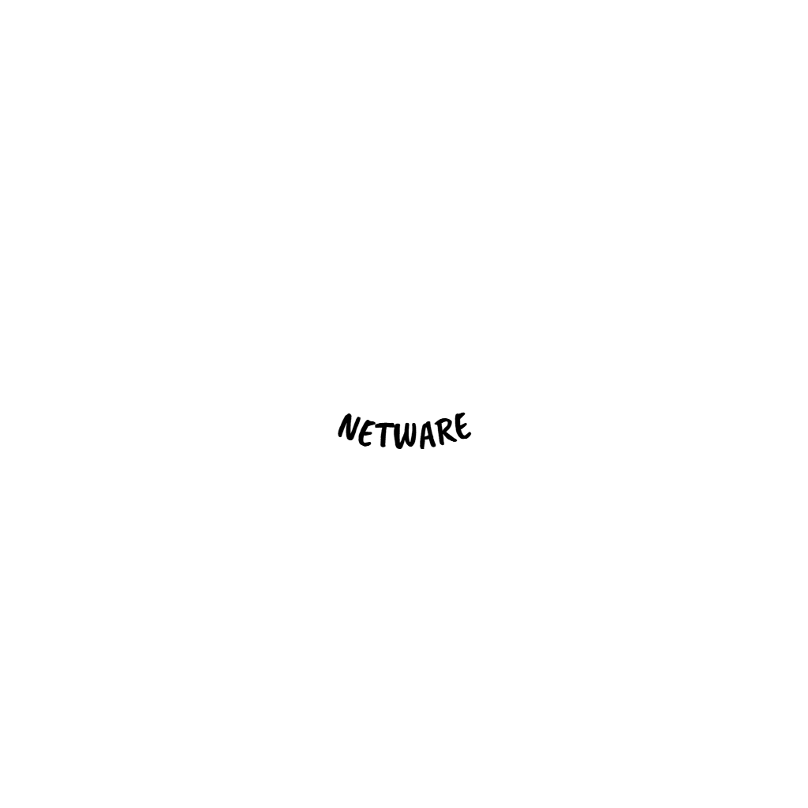

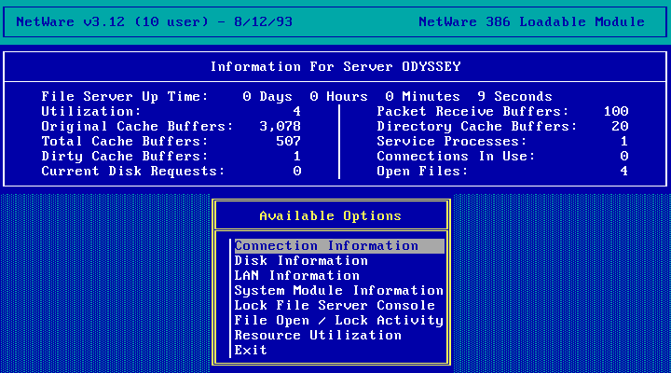
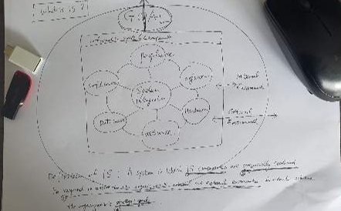
WHAT IS INFORMATION SYSTEM (IS)
A System in which (1)IS Component are (2)Organically Combined to Respond in Unison to the Organizations (3)Internal and External Environment in Order to Achieve the Organizations (4)Strategic Goal
INFORMATION SYSTEM 6 COMPONENTS
PEOPLEWARE - includes all the people involved in developing, operating, and using an information system.
HARDWARE - includes all the physical devices that support the operation of an information system..
SOFTWARE - is the set of programs and applications that tell hardware what to do and enable users to perform tasks in an information system.
ORGWARE - is the Organizational structure, policies, and processes that support the effective use of an information system, focusing on people and workflows rather than technology.
Only the field is different
Like as Agriculture, account, NFA,DA,Hospital,college…..
SYSTEM INTEGRATION
DATAWARE - refers to the data resources and structures used in an information system, including how data is stored, organized, managed, and retrieved.
NETWARE -is the set of hardware and software components that enable data communication and connectivity within and beyond an organization
3

Slide 4
The history of ( K-Economy,K-AIS ) Success or Failure
Rows(5)/Columns(70) | 1950 | 1960 | 1970 | 1980 | 1990 | 2000 | 2010 | 2020 | 2030 | 2040
Economy entity | 1.Eat | 2.Wear | 3.House | 4.Car | 5.Phone | 6. Health | 7.Health | 8.Health | ? | Compressed History of Mankind
MOM(play a vital role) –> University | Agri culture | Fiber | H-Steel-ship chemistry | Electrical / electronic | Computer IS, A.I | Medicine | Medicine | Medicine |  | Of Korea history
Enterpreneur Army |  | Agri culture | Fiber | H-Steel-ship chemistry | Electrical/electronics | Computer IS, A.I | Medicine |  |  | Change every 10 Y
Research Institute |  |  | Agri culture | Fiber | H-Steel-ship chemistry | Electrical/electronic | Computer IS, A.I | Medicine
Gov.(support,Interference)free riding |  |  |  | Agri culture | Fiber | H-Steel-ship chemistry | Electrical/electronic | Computer IS, A.I | Medicine
Specification or stability cash cow |  |  |  |  | Agri culture | Fiber | H-Steel-ship chemistry | Electrical/electronic | Computer IS, A.I | medicine
What will be the lessons of failure?
- Fiercely competitive society -> low birth rate, high suicide rate, avoidance of marriage, and the belief that money is everything
What to benchmark?
- Selection and concentration among national development chains (Agricultural sector strategy->Information strategy-> essential selection(1) and concentration(2))

Slide 5
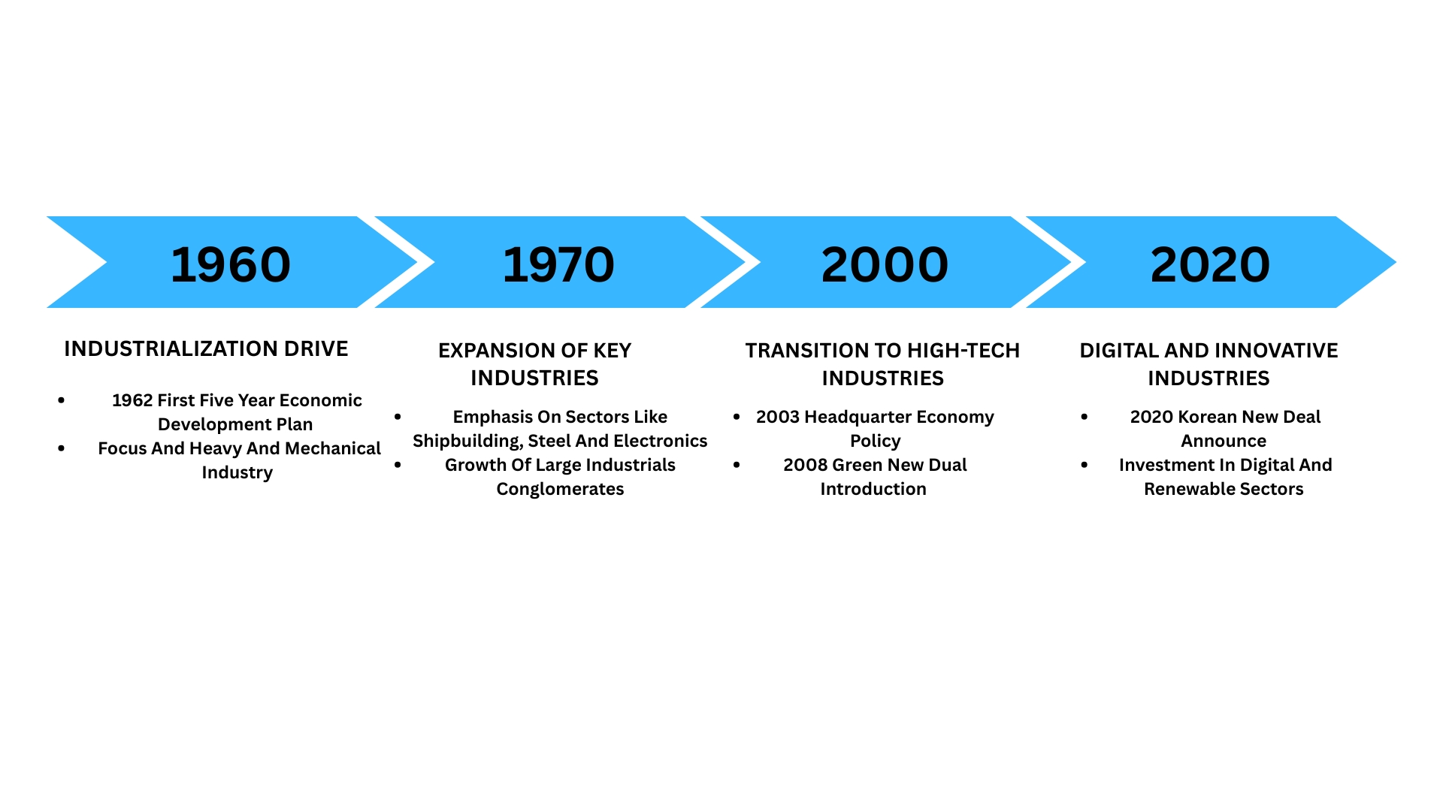
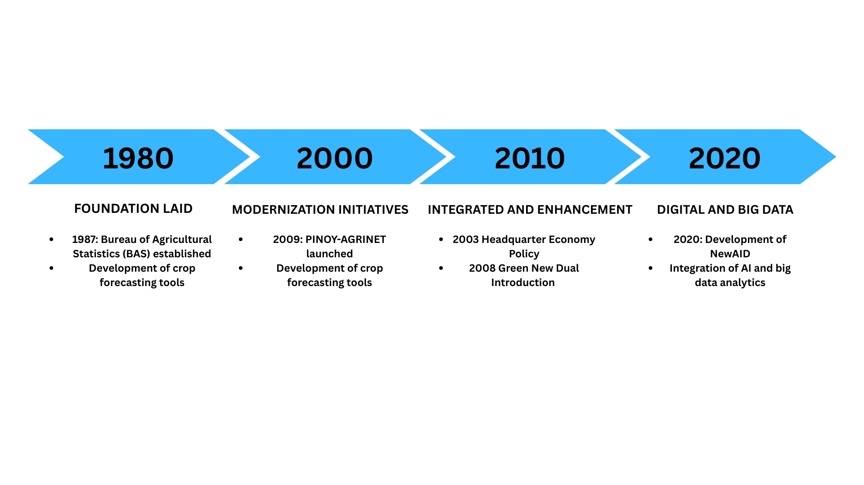
History of industrial System in Korea <by chatGPT> Trend
X
History of Agriculture Information System in the Philippines <by chatGPT)> Trend

Slide 6
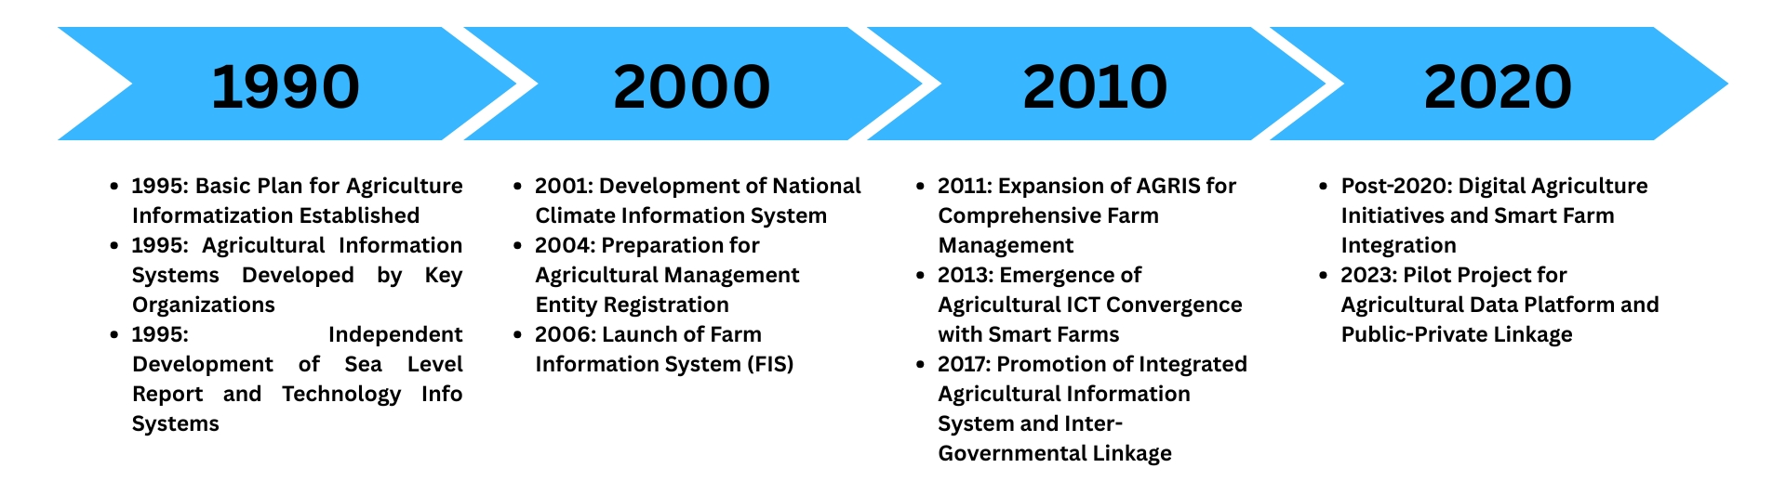
THE HISTORY OF THE K-AIS BEGINS IN THE 1990S(1980 world 1st )?)
What should be benchmarked from KAIS’s 50-year history?
Key CSF - Integrated Database & AMIS Organization Long-term Strategy
Diversity of Members (IT, Strategy, Agriculture), Sustainability
Technology < Strategy → Integrated System (Increased Budget)

Slide 7

AIT & AIS SCOPE
Expand outsourcing
Audit
Artificial Intelligence Related
Robotics System
(Department of Defence
Tomato video )
Etc..
Pattern Recognition System(disease)
Existing Information System
Automatic
Recognition
System(sensor)
(varies by department and detailed area)
Smart Board
(Summary DB)
Kiosk System
Remote Control System
(Unmanned information terminal)
(Smart Farm)
What should be benchmarked?
As the scope of tasks involving new technologies increases across all sectors, it is not feasible to hire new personnel each time, and it is difficult to manage with retraining of existing staff.
As a solution, government ministries and large corporations are promoting outsourcing by cultivating dedicated outsourcing personnel.
In South Korea’s case by now, the trend is for information departments not only to focus on information technology (IT), but also to outsource information systems (IS) development rather than developing them in-house.

Slide 8
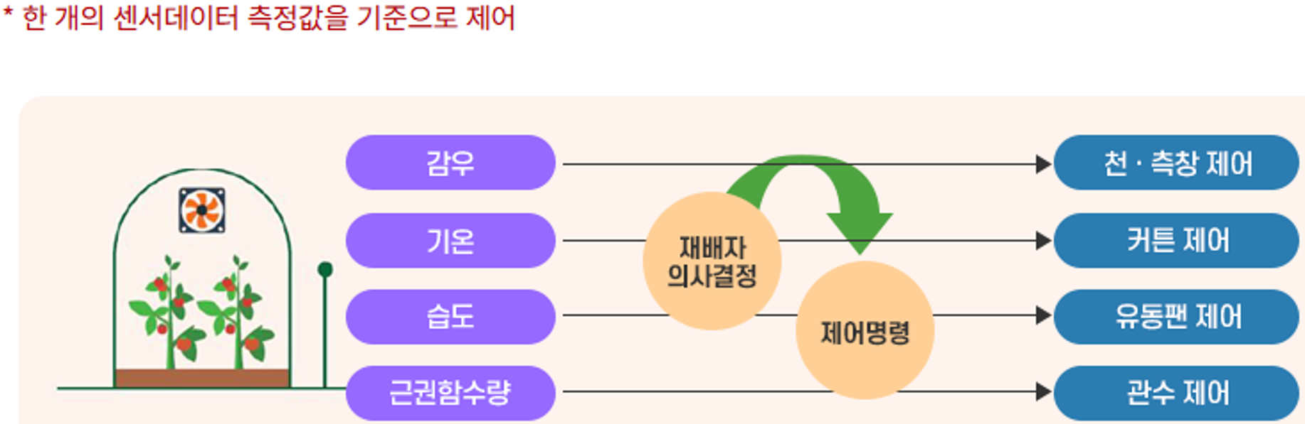
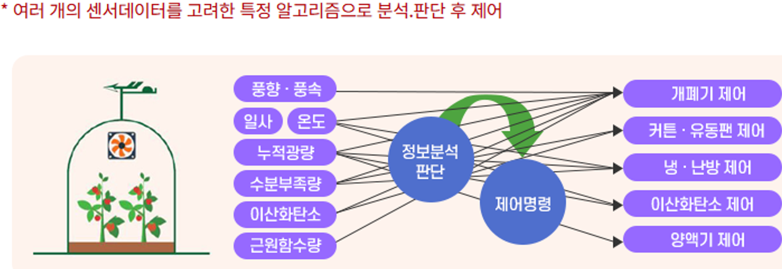
IMPORTANT RESEARCH AND DEVELOPMENT CASES RELATED TO KAIS (AUTOMATIC CONTROL)
X
What to benchmark?
Agricultural uncertainty - typhoons and abnormal weather are more severe
Customizing technology & mindset needed according to individual Philippine farm situations
Recommended to focus on benchmarking necessary sectors
Solution -> Outsourcing Mgt.(not self do)

Slide 9
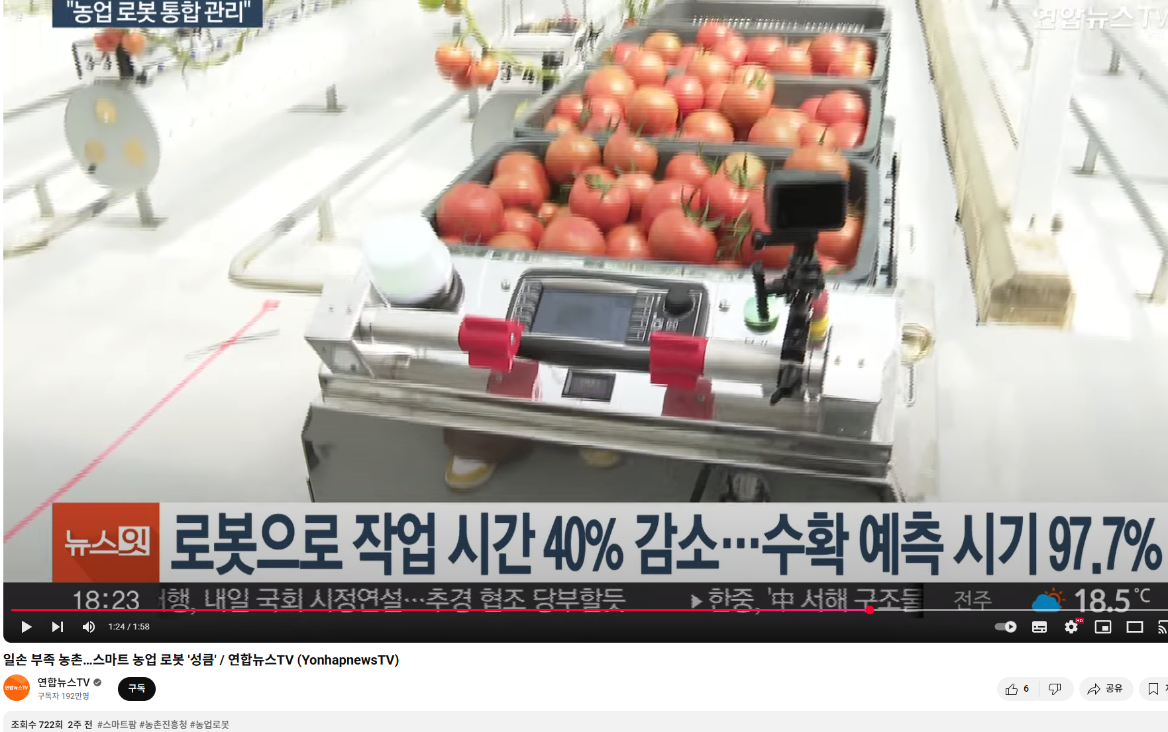
IMPORTANT RESEARCH AND DEVELOPMENT CASES RELATED TO KAIS (ROBOTS) - CASE VIDEO
What to Benchmark?
-The recent topics of agricultural innovation are digitalization and automation robotization
-Also stated in the Philippine Five-Year Plan theme
-Benchmarking outsourcing and industry-academia-government-research linkage methodologies
https://youtube.com/shorts/BrwIPcL76sA?si=nc-MMZhHhyMnQZnQ
Robot

Slide 10
THE RELATIONSHIP BETWEEN KOREAN’S IS & SDLC
cost
SDLC
TIME
INNOVATION
STRATEGY
PLANNING
ANALYSIS
DESIGN
PROGRAMMING
MAINTENANCE
2020
2010
2000
1990
1980
1970
1960
1950
Korean
History
Developed Countries
Overcome
Crisis
Democratization
stable
88 olympic games
High Growth
Industrialization
Underdeveloped
Country
IS Career
(personal)
KREI
(Model)
MOST
(Director)
KIST
Olympic Game
IS(DB/IRS)
Auditor
counsulting
ISP/BPR,
EVALUATION
SAMSUNG
IS(DB pgm)
Hungry (rice)
USA (Bread/Milk)
K-AIS
Consultant
83.5
(2024)
70.4
(1983)
62.3
(1960)

Slide 11
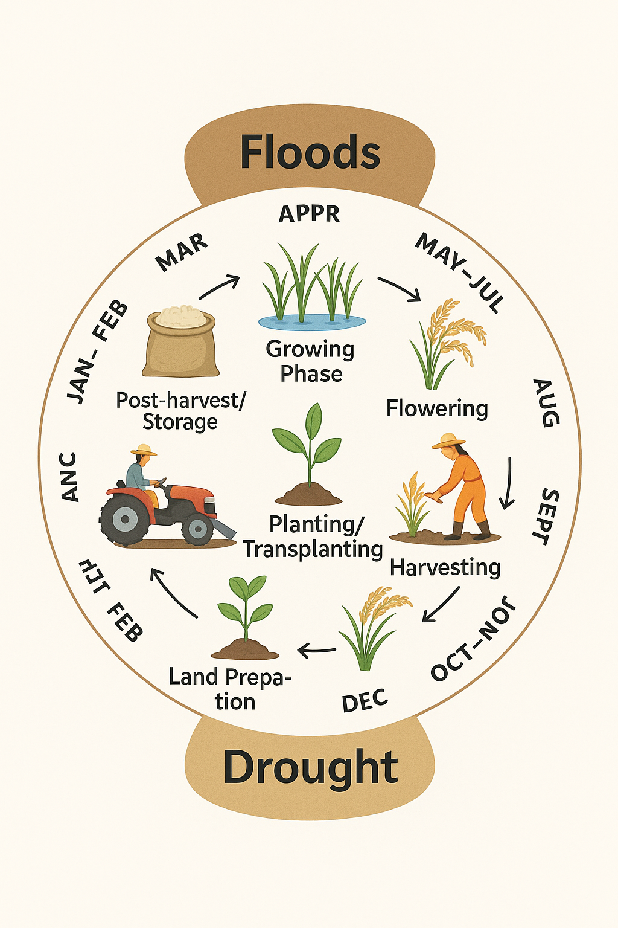
FOUR (4) KEY STRATEGIES
X
1
CLIMATE CHANGE ADAPTATION
(shift production, adjust planting calendars, crop diversification).
2
FARM CLUSTERING AND CONSOLIDATION
(convergence of intervention)
3
3
VALUE CHAIN APPROACH
(Integration approach -3A agricultural production, agri-business, agro-industrialization).
4
DIGITAL TRANSFORMATION
(ICT,IOT,RS,AI)

Slide 12



AGRICULTURE STRATEGY & INFORMATION TREND
X
ITEM
NFA, Philrice IS key Issue?
REMARKS
SCOPE ( MINIMUM?START)
BIGDATA
SUMMARY DATABASE
TIMESERIES (LONG ? TERM)
FORCASTING,ECONOMETRIC ANALYSIS -> DsS
SMART FARM
E-TRANSFORMATION
ADVANCEMENT OF SYSTEM MIND
CHANGE IS CONSTANT (“IS” IS MIND, CULTURE)
FIELD ORIENTED ADMINISTRATION & INFORMATION
FIELD MONITORING FOR SYSTEM
BALANCING BETWEEN CENTRALIZED SYSTEM AND DISTRIBUTED SYSTEM
ROBOT, DRONE, AI
RELATED ALL FIELD RAW DATA, PEOPLE
What to benchmark?
- Establishment of independent AIS organization (started in 1986 -> Full organization around 2000)
- Diversity of members (computing, strategy, agriculture), effectiveness in 10-20 years, sustainability
- Collaboration, research, strategic services -> research institute, company, advanced technology, AI

Slide 13
KOREA'S INDUSTRY-ACADEMY-GOVERNMENT-RESEARCH Institute CHAIN FROM A POOR COUNTRY TO A DEVELOPED COUNTRY IN 60 YEARS (AGRICULTURAL INFORMATION SYSTEM-INDUSTRY HISTORY)
1.Samsung founder lee byung-chul puts more effort into corporate farming than into Samsung electronics semiconductors
2.Korea’s best corporate farming information system(cJ Divide & change) -> pig information system
(clothes,distribution company,
cosmetic )->( Food ,Culture,Movie )
0.Starting in the mid-70s and developed in the 80s, the goal is to become the worlds NO. 1 pig farming information system
4.Daily report ( dashboard
summary table – summary
DB –CSF ) sow turnover rate, litter size, preventive injection management, shipping time prediction, feed formula – Korea’s best -> . world class
3.Pig farm – 40,000 pigs – > cash cow role(5M$) -> closed due to government pollution industry regulation -> degeneration of agricultural information system(more pollution by each farmers, Interference?)
Pig Farm
WHAT TO BENCHMARK?
Importance and support for specific large-scale corporate farms
The best agricultural (information system) field IS technology is created by companies
WHAT SHOULD WE TAKE AS LESSONS FROM FAILURE?
Excessive corporate regulation leads to regression in technology and productivity (which side of the coin to choose?)
After Samsung's pig farms were closed, small-scale agricultural information system companies emerged, focusing on livestock farming.

Slide 14
"The Development Chain of Industry-Academy-Government-Research Cooperation in Korea, Which Transformed from One of the Poorest to an Advanced Nation in 60 Years ( Agricultural Information Systems about University History)”
1
University Department
In the 1990s the Department of Agriculture Economics at Seoul National University established a major in information science .
2
PROFESSOR
Shortage of professors and lecturers in the 2000s
Due to a lack of students, agricultural information system and regional information system are taught in the same classes as urban planning and agricultural civil engineering. (2003 ~?)
3
STUDENT
JOB
CLASSIFICATION
4
Shortage of professors and lecturers in the 2000s, 2010 add AIS
What should we take as lessons from failure?
Agricultural information system talents ->other industries
Preference for those with convergence majors and in-house retraining are necessary
What to benchmark?
Inserting agricultural information system as a classification code in the industrial classification occupation group

Slide 15
HISTORY OF THE K-AIS
(SUMMARY BY YEAR:Government)
What lessons will you take from failure? (people)
80s and 90s - Agricultural information system personnel were not treated as important.
There were many non-regurarl positions
Managers were non-major administrative positions -> Many problems were solved by the introduction of technical examinations(high position)
What to benchmark?
- Establishment of a small Independent AMIS
organization(not Government only support)
- Diversity of members (computing, strategy, agriculture), sustainability

Slide 16
SUMMARY OF CHANGES IN THE KREI INFORMATION SYSTEM ORGANIZATION-Research
ORGANIZATION NAME/FORM
PERIOD
KEY FEATURES AND ROLE CHANGES
Computer room or telecommunication management office
Start of database research data
1990s
Computerization of internal reports and statistical data
Focus early information management system
Information management team or IT information forest
KREI team site operation launched
Early 2000s
Online service of research reports
Introduction of internal data search system
Information strategy team or information management office
Development and Introduction of knowledge management system (KMS)
Late 2000s
Digital content management
Agricultural statistics system connection
Information and computer room or information planning room
Strengthening policy support based on big data
2010s
Development and Maintenance of KREI Agricultural Observation System
Expansion of government/local government linkage system
Digital strategy team / information planning team (integration/strengthening)
Establishment of digital transformation strategy
2020s
AI-based agricultural prediction research project
Participation in agricultural data fusion and open platform
THE KOREAN RURAL ECONOMICS INSTITUTE (KREI)’S INFORMATION SYSTEM
In the 80s, the ministry of agriculture, food and rural affairs SW house (5 people dispatched from the ministry of agriculture, food and rural affairs) conducted comprehensive research and implementation of the national agricultural information system, in the 90s it was transformed into a separate organization, such as an independent agriculture information and education organization.

Slide 17
HISTORY OF KIST(SERI)-System Integration(* only IS part)
X
and the establishment of a research computer network from the late 1980 to the early 1990s KAIST SERI stands for ‘System Engineering Research Institute; and is an institution that has played a pivotal role in the development of the information industry and science and technology in Korea. In particularly, it made important contributions to the introduction of the national supercomputer
started as the system engineering centre under KIST and later developed into the systems engineering research institute
In the late 1980s , SERI introduced Korea’s first super computer, the cray-2s causing a turning point in the domestic science and technology community.
1. ESTABLISHED AND EARLY ACTIVITIES
2. ESTABLISHED OF RESEARCH COMPUTER NETWORK (KREONET)
Since 1968, SERI has been in charge of the construction of a research computer network under supervisor of the ministry of science and technology
This project aimed to advance science and technology in KOREA by providing cutting-edge internet-based supercomputing
3. Center of Information Industry Development
From the introduction of computers in the 1960s to the 1980s, SERI was at the center of Korea's information industry history.
Under the leadership of Dr. Seong Ki-gu in particular, SERI played a pivotal role in the development of the domestic information industry.
WHAT TO BENCHMARK?
Reviewing the Need to Establish an Agricultural Information Organization to Prepare for Uncertainty
WHAT WILL BE THE LESSONS LEARNED FROM FAILURE?
100% of SW HOUSE founding members have moved on
Unrelated people take over and run a separate independent organization

Slide 18
WHAT IS THE COLLABORATIVE RELATIONSHIP BETWEEN INDUSTRY, ACADEMIA, GOVERNMENT, AND RESEARCH TO ADDRESS UNCERTAINLY IN AGRICULTURE
✅ Industry-Academia-Government Collaboration System to Respond to Agricultural Uncertainty
(Uncertainty → Information, Measures → Information)
SECTOR | ROLES AND TASKS
Industry - Corporations | - Develop and commercialize smart farming technologies - Supply agricultural equipment using drones, IoT, sensors, etc. - Provide weather data, satellite images, smart farm data (cloud platforms)
Academia (Universities, Research Institutes) | - Conduct joint research and data analysis - Study and develop agriculture-related technologies - Research on early diagnosis of pests/diseases and climate change response - Analyze supply/demand and price fluctuations of agricultural products
Government - Authorities | - Provide accurate policy directions and information - Establish and operate data collection systems for climate, pests/diseases, prices, etc. - Share statistical and information systems (e.g., agricultural outlook center)
Expert Organizations / Research Institutes | - Offer policy proposals (e.g., KREI: Korea Rural Economic Institute), agricultural outlook reports - Analize global market trends - Support government policy making - Produce comprehensive statistics and data
Agriculture faces various uncertainties such as climate change, disease outbreaks, price fluctuations, and policy changes. An effective response to these challenges requires a collaborative system involving industry, academia, and government. Below is an outline of the structure and specific roles of each sector in this collaboration system for addressing agricultural uncertainty.

Slide 19
EXAMPLES OF COLLABORATION CASES
X
Rural Development Administration + Universities + Private drone companies + Ministry of Agriculture, Food and Rural Affairs
→ Joint development of an AI-based real-time pest/disease forecasting platform
PEST/DISEASE FORECASTING
Korea Institute of Agricultural Science & Technology + ICT companies + University research institutes + Local governments
→ Implementation of automated control systems in facilities
SMART FARM SUPPORT
KREI (Korea Rural Economic Institute) + University modeling labs + Major distribution companies + Ministry of Agriculture, Food and Rural Affairs
→ Establishment of a supply-demand forecasting system for key exported agricultural products
AGRICULTURAL SUPPLY AND DEMAND FORECASTING
Data Sharing System: | Need for data standardization and an integrated platform among industry-academia-government-research sectors
Sustainable Financial Support: | Secure mid- to long-term R&D and demonstration budget from the government
Reflecting Field Feedback: | Develop customized technologies that reflect the actual needs of farmers
Establish Governance: | Continuous operation of a joint steering body or consultative organization among industry-academia-government-research sectors
Attributes of Information Collaboration in Agricultural Information Systems (AIS) in Response to Agricultural Uncertainty
Predicting and analyzing information in response to agricultural uncertainty is more difficult than in other industries.
Early economics and statistics developed with a focus on agriculture.
AIS (Agricultural Information Systems) must be based on the premise that they are more complex than those in the secondary, tertiary, and quaternary industries.
AIS is a system that challenges the impossible, involving not just technology but also socio-humanistic elements.
In the case of the Philippines, the frequency of typhoons is above average, increasing uncertainty, making it necessary to establish an early warning system.
A system that continuously operates causal analysis and prediction of production factors, and prepares for changes in those factors, is needed.
Addressing and overcoming uncertainty is ultimately a data-related matter, and it is recommended to establish a dedicated organization for leading information collaboration.

Slide 20
Self-Assessment and Key Consulting Summary Table Based on KAIS Benchmarking Criteria
STAGE
SELF-ASSESSMENT SUMMARY
CONSULTING KEYWORD
STAGE-BASED ANALYSIS
1. Personal Internal
Development
Enhance Staff
Ability
1. Improve documentation capability
Outsourcing only few
2. The Korean audit of outsourcing
It seems like a situation moving from stage 1 to stage 2
2. Outsourcing
3. Management
ICT(Convergence Technology)
Immediate design and implementation needed
3.Summary DB(Jump)
4. System
Integration
Regional, Stakeholder
4. Benchmarking and Customization
Independent step-by-step parallel process needed
What lessons should be learned from failure?
Simplification of initial outsourcing management
Transparency
Technology management
Advancement of supervision (or auditing)
What should be benchmarked?
Laws, Regulations
Outsourcing
Auditing, Management
Systems, Mind etc.

Slide 21
BY NOLAN MODEL – CONSULTING SUMMARY –
SELF DIAGNOSIS BY NOLAN MODEL REPORT
Self Diagnosis summary (diagnosis, problem)
Consulting recommendation (improvement plan)
Consulting Recommendation type
When to improve
Important or not
Nolan 4th stage (current stage)
Cooperation
1. Initialization
Enhance Staff Ability
(1) Improve and Implementing Document Mind-set
Essential
Short Term
Consultant (form discussion etc.)
2. Expand
Outsource only few
(2) Self-evacuation and Outsourcing Supervision
Discussion
Mid Term
3. Control
ICT(Convergence
Technology)
(3) Summary DB
Essential
Long Term
Consultant (Design Together)
Region, Stake Holder
Information Transfer Between Region and Stakeholders –in process
Suasion
Long Term
Central, distributed – self strategy (short- term, long term)
4. Maturity
What lessons should be learned from failure?
Expansion stage ->
What should be benchmarked?
Stages 2 to 3, 2010–2020 K-AMIS

Slide 22

Important KAIS Research and Development Case
(Integrated Agricultural Information System Strategic Planning should be initiated first)
X
Agricultural DB Construction Procedure (by Stage)
Stage 1:
Stage 2:
Stage 3:
Data Collection
Data Cleaning and Standardization
DB Design and Construction
Stage 4:
Stage 5:
Linkage and Development
Analysis and Visualization
EXAMPLES OF MAJOR SYSTEMS
System Name | Operating Organization | Main Function
Korea Agricultural Observation Information System (KASIS) | KREI (Korea Rural Economic Institute) | Monitoring production, consumption, and prices of crops
Agricultural Management Information System | Ministry of Agriculture, Food and Rural Affairs | Registration of management entities and farming statistics
Agricultural Meteorological Information System | Rural Development Administration | Forecasting weather and pest statistics
e-National Indicator / National Statistical Portal | Statistics Korea | Integrated access to national statistics

Slide 23
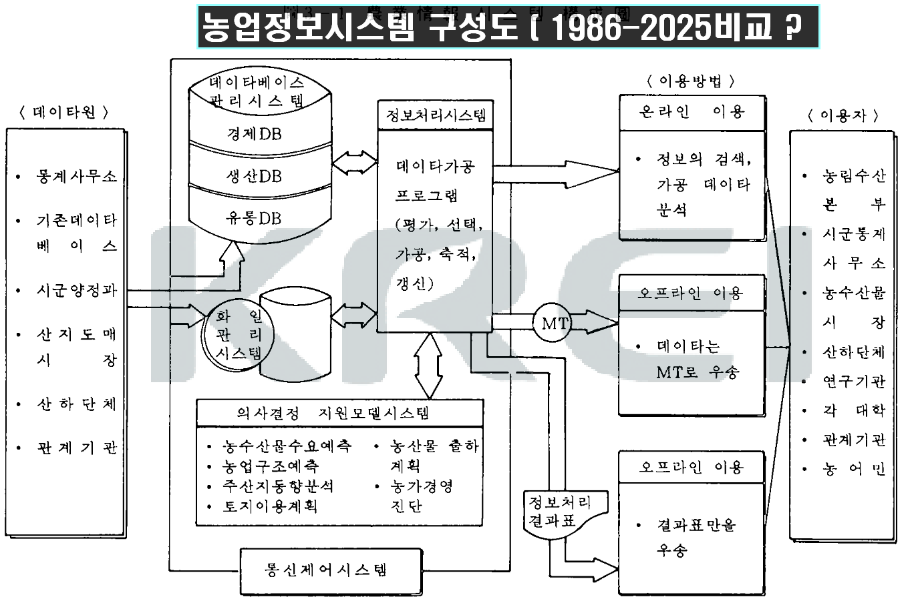
Important research and development cases related to KAIS (example of a strategy report from 40 years ago: Start with a strategic plan and benchmark it)
X
What should we take as lessons from failure?
Time series data, sample consistency
Future inter-agency information linkage, exclusion of duplicity
What to benchmark?
Maintain accurate statistics by field (divide and conquer -> summary DB)
Stable organization operation
ISP for the entire agricultural information system

Slide 24














"Important Research and Development Cases Related to KAIS (Strategic Report from 40 Years Ago: It Started with Strategic Planning and Benchmarking)"
"Agricultural Information System Configuration (Comparison between 1986 and 2025?)"
Usage Method
Database Management
System
Data Sources
  Statistics Office
  Existing Database
  City/County Forestry Department
  Forest Map Vendor
  Forestry Organizations
  Related Agencies
Online Use
USERS
Statistical DB
  Headquarters of Agriculture, Forestry, and Fisheries
  City/County Statistical Offices
  Agricultural and Fishery Markets
  Affiliated Organizations
  Research Institutions
  Each University
  Related Institutions
  Farmers and Fisherfolk
Information Processing System
Information search, processed data analysis
Production DB
Utilization DB
Data Processing Program
(Evaluation, Selection, Processing, Storage, Update)
HR Management
System
Offline Use
MT
Data is sent by MT
Information Processing Result Table
External Environment Support Model System
  Forecasting Agricultural Product Demand
  Agricultural Structure Adjustment
  Regional Promotion Method
  Land Use Planning
  Agricultural Resource Planning
  Agricultural Management Diagnosis
Offline Use
Only result tables are sent
Communication
System
What should we take as lessons from failure?
Time series data, sample consistency
Future inter-agency information linkage, exclusion of duplicity
What to benchmark?
Maintain accurate statistics by field (divide and conquer -> summary DB)
Stable organization operation
ISP/BPR for the entire agricultural future IS(Preparation Stage)

Slide 25
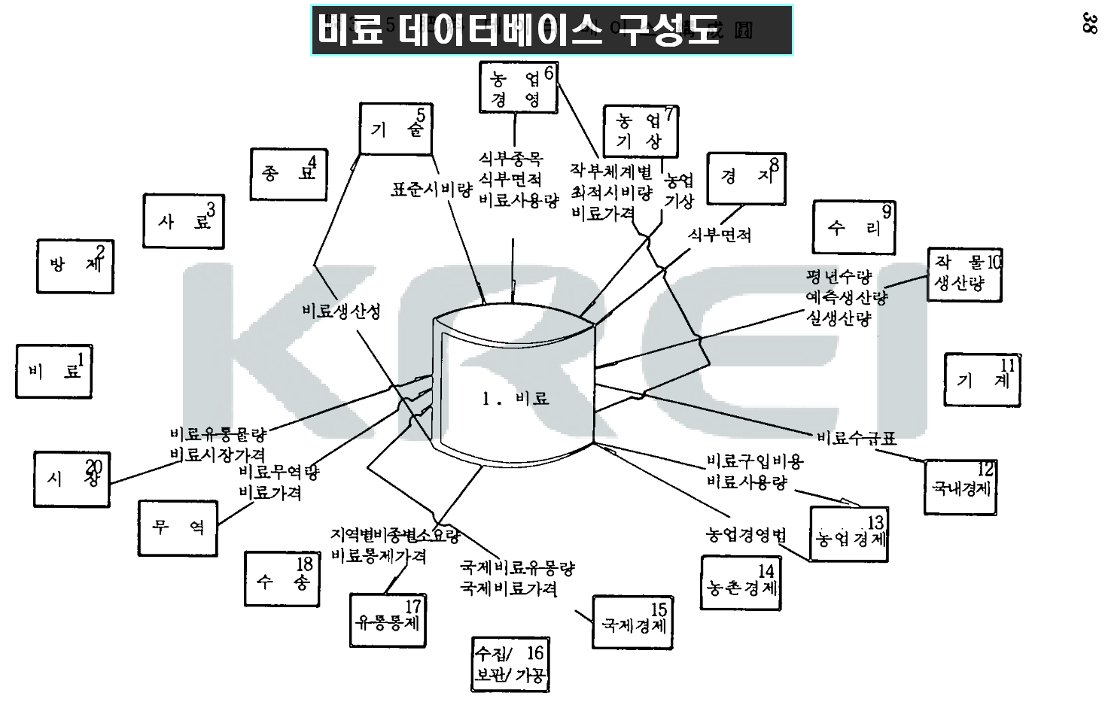
IMPORTANT RESEARCH AND DEVELOPMENT CASES RELATED TO KAIS (EXAMPLE OF A STRATEGY REPORT FROM 40 YEARS AGO: START WITH A STRATEGIC PLAN AND BENCHMARK IT)
X
What should we take as lessons from failure?
Time series data, sample consistency
Future inter-agency information linkage, exclusion of duplicity
What to benchmark?
Maintain accurate statistics by field (divide and conquer -> summary DB)
Stable organization operation
ISP for the entire agricultural information system

Slide 26
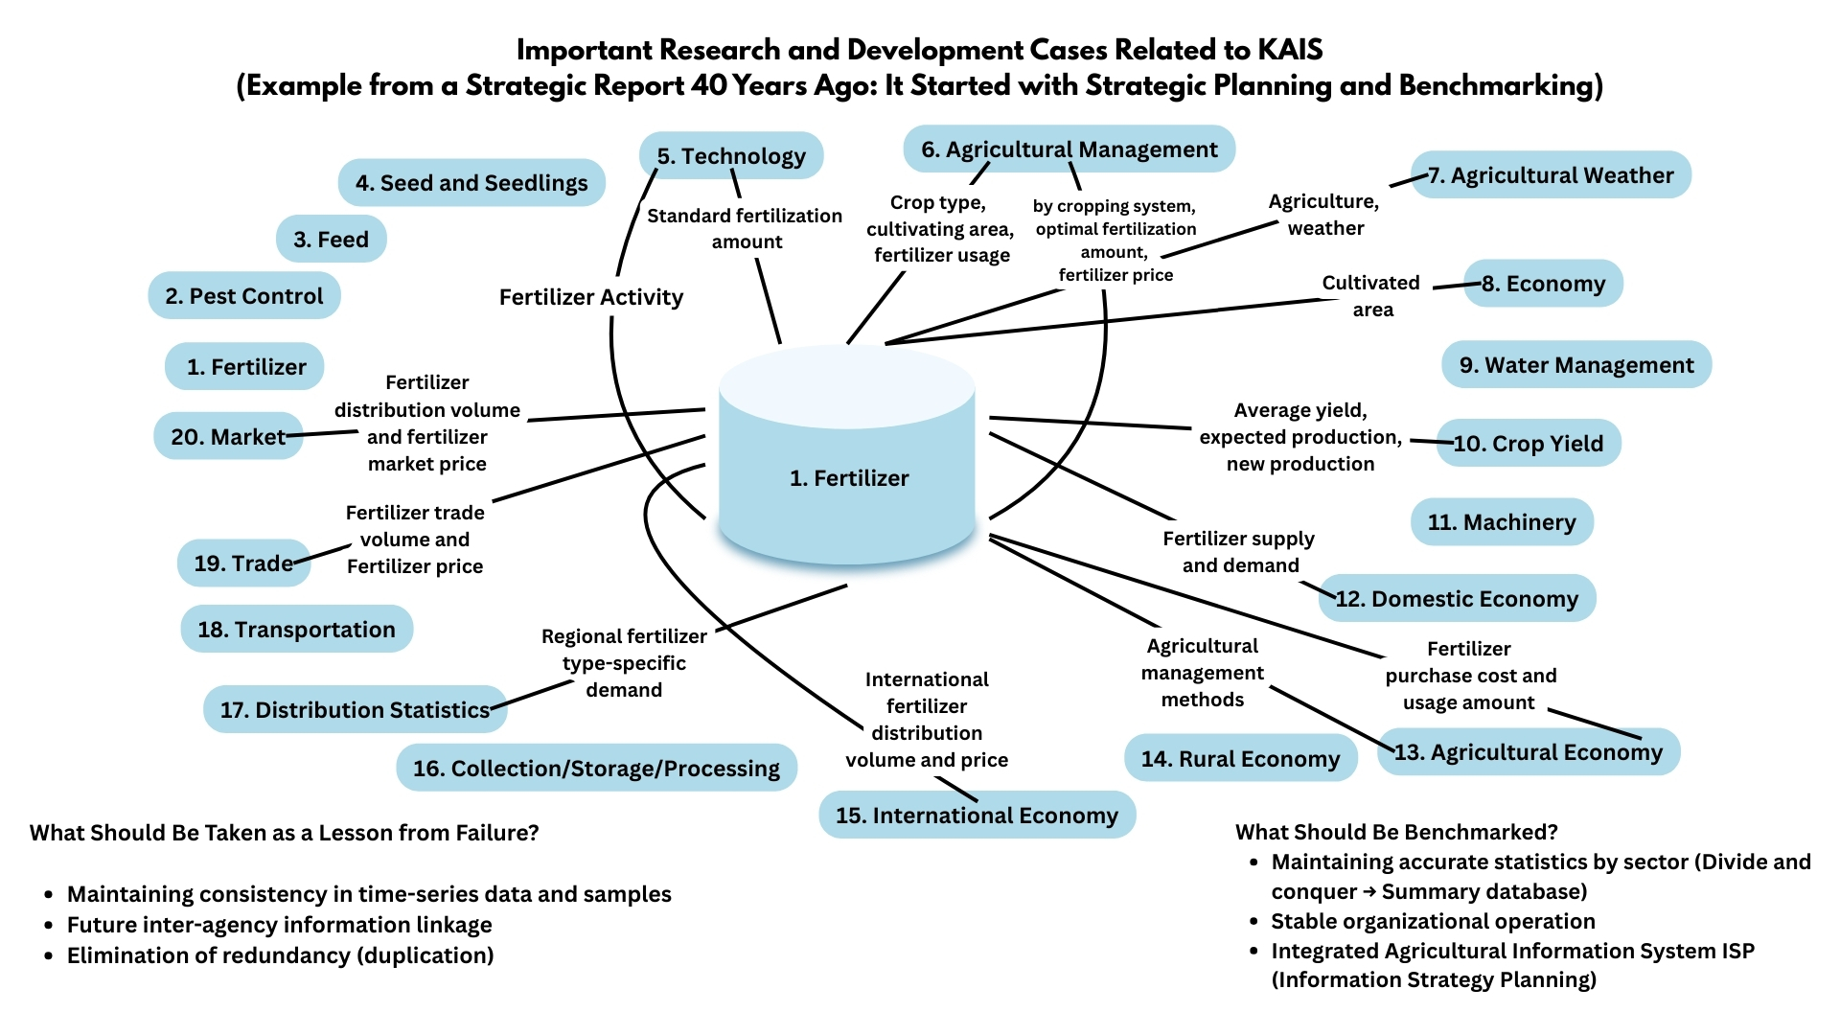

Slide 27
IMPORTANT RESEARCH AND DEVELOPMENT CASES RELATED TO KAIS
( Research on rice yield prediction model – approach and utilization of quantitative model )
RICE PREDICTION MODEL COMPONENTS
1
2
3
INPUT DATA
PREDICTION ENGINE
OUTPUT DATA
Weather Information (e.g., rainfall, sunlight hours, temperature)
Soil Information (e.g., pH, organic matter)
Crop Traits (e.g., disease resistance, growth period)
Cultivation Info (e.g., planting density, fertilizer usage, irrigation status)
Remote Sensing & Drone Images (e.g., NDVI and other vegetation indices)
Statistical Models (e.g., multiple regression, ARIMA)
Machine Learning (e.g., Random Forest, XGBoost, LSTM)
Deep Learning (e.g., CNN+LSTM with satellite data)
Predicted Yield (kg/ha)
GIS-based Spatial Visualization of Yield
WHAT TO BENCHMARK?
Simple is best, (Regression analysis: 1000-rip, sunlight, rainfall/expert's eye)
Major items dashboard life
✅ Rice Yield Prediction Model
Rice yield prediction is very important for responding to agricultural uncertainty and for planning agricultural policy and production.
WHAT LESSONS WILL WE TAKE FROM FAILURE?
- Research for Research -> Practical Application

Slide 28




X
1. EXAMPLES OF KEY SYSTEMS
SYSTEM NAME | OPERATING AGENCY | MAIN FUNCTION
Agricultural Observation System | KREI | Observation of production, consumption, and price by crop
Agricultural Management Information System | Ministry of Agriculture | Management and statistics on farm registrations
Agricultural Meteorological Information System | Rural Development Administration | Climate and pest prediction statistics
e-Nara Index / National Statistics Portal | Statistics Korea | Integrated access to national statistics
2. Suggestion: Strategy for Enhancing Data Utilization
Build an Integrated Platform
Expand Education & Utilization for Farmers
AI-Based Forecasting Service
Standardization & Quality Management System
What lessons will be learned from failure?
Initial departmental and agency-level work division and shared information research agreement (the later it is, the more fixed it becomes and the more integration costs increase)
What to benchmark?
Public service, general information, direct transaction, home page support, competition, etc.

Slide 29
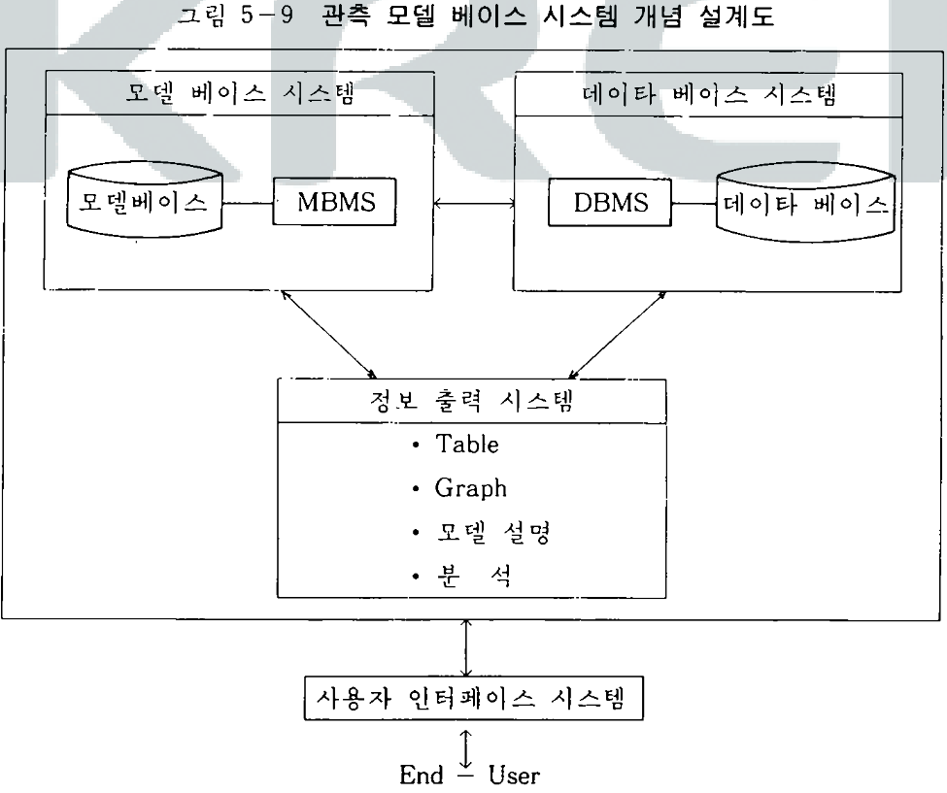
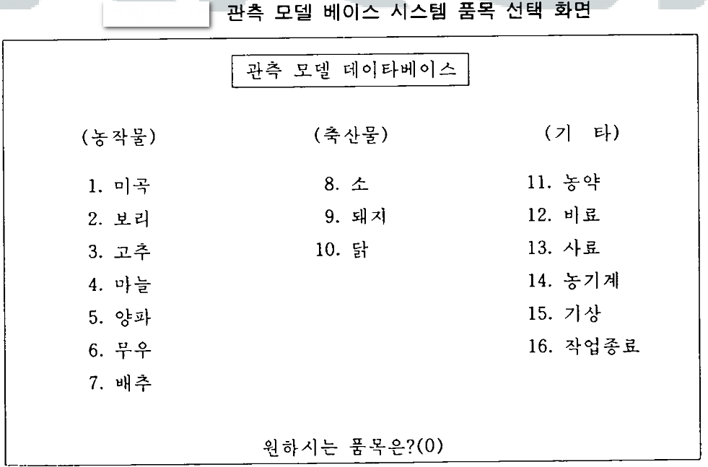
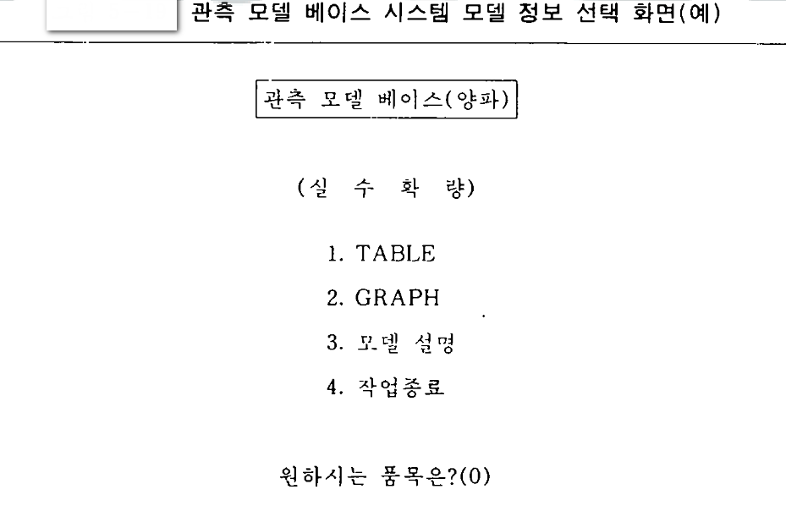
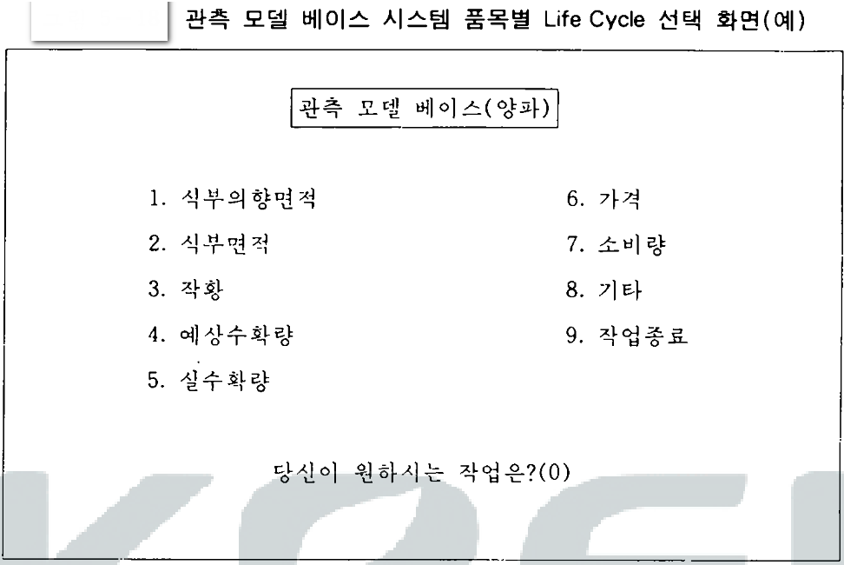
KAIS 관련 중요한 연구 및 개발사례 (농업의사결정지원시시템)
X
무엇을 벤치마킹 할 것인가?
매일일상 일일보고 대시보드 수준향상
40년전 삼성의 양돈정보시스템이 세계수준급인 이유는?
무엇을 실패의 교훈으로 받아들일 것인가?
중복연구 배제

Slide 30
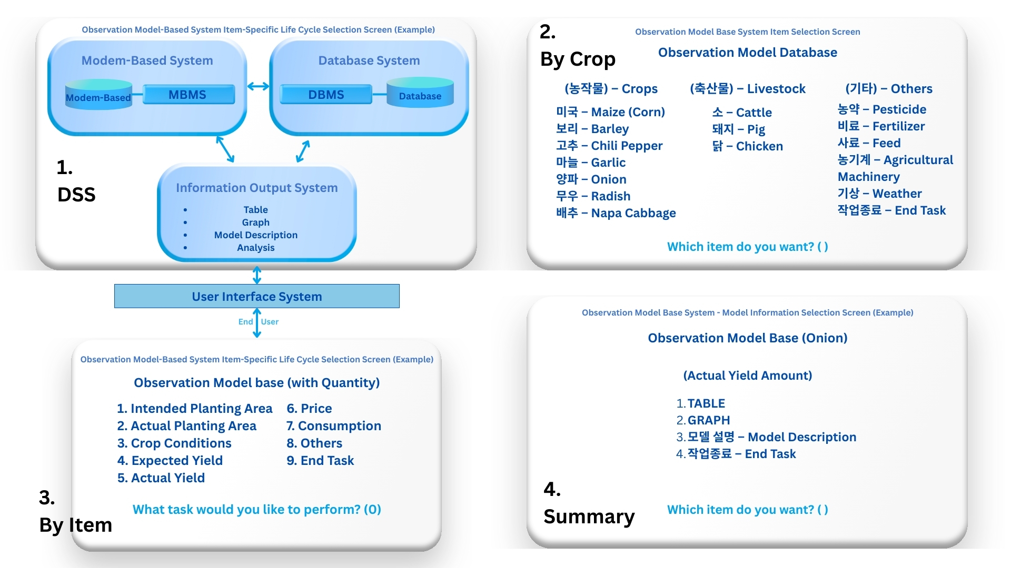
"Important Research and Development Cases Related to KAIS (Agricultural Decision Support System)"
What should be benchmarked?
- Daily routine daily report – Improving the level of the dashboard
Why was Samsung’s pig farming information system from 40 years ago world-class?
What should be accepted as a lesson from failure?
- Eliminating redundant research

Slide 31
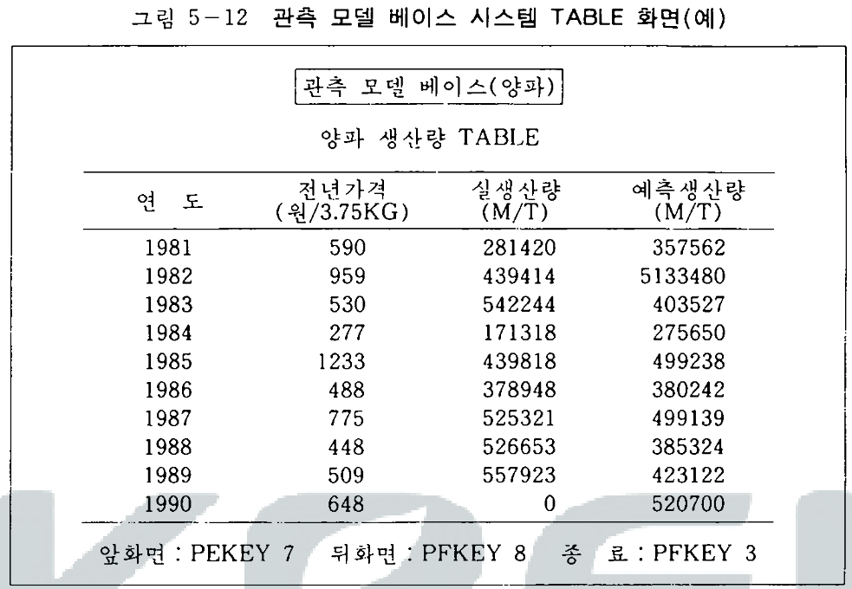
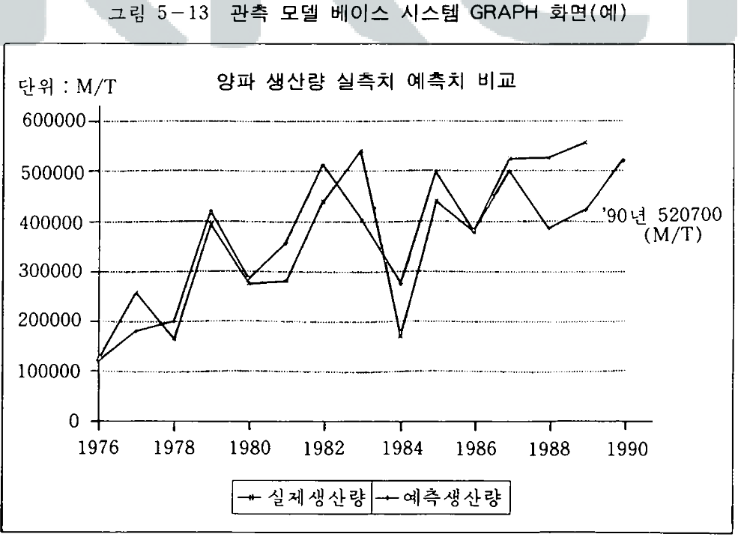
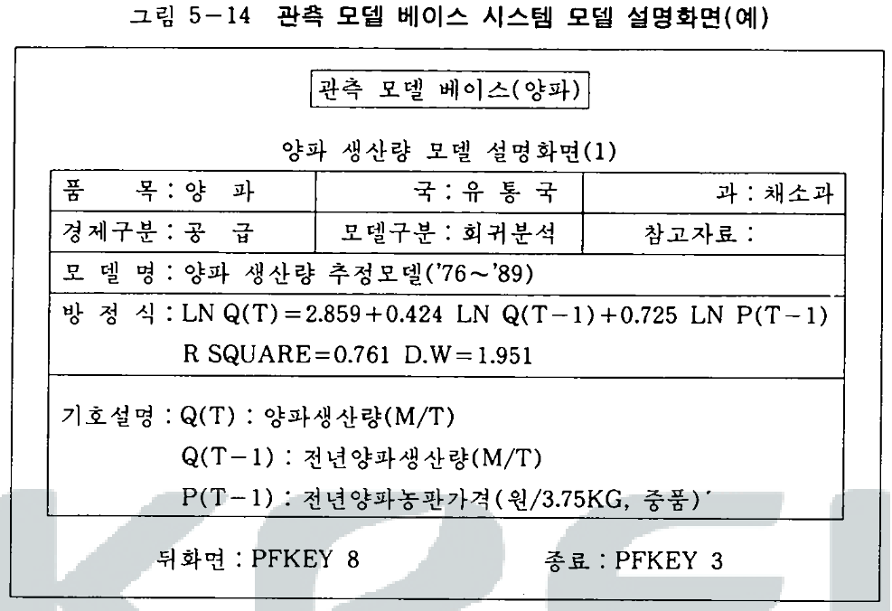
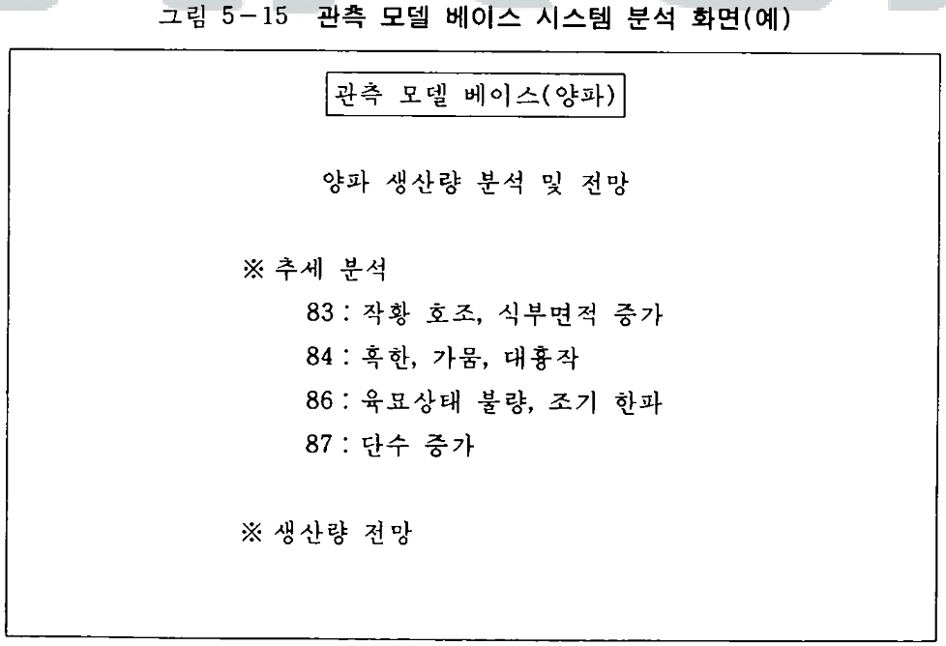
Important Research and Development Cases Related to KAIS (Agricultural Decision Support System)
X
2.
Graph
3.
Model
4.
Decision
What lessons will we take from failure?
Continuous management and maintenance of the system
Establishment of a dedicated team or appointing responsible personnel
What should we benchmark?
Early warning system
Analysis reports on key decision-making points

Slide 32
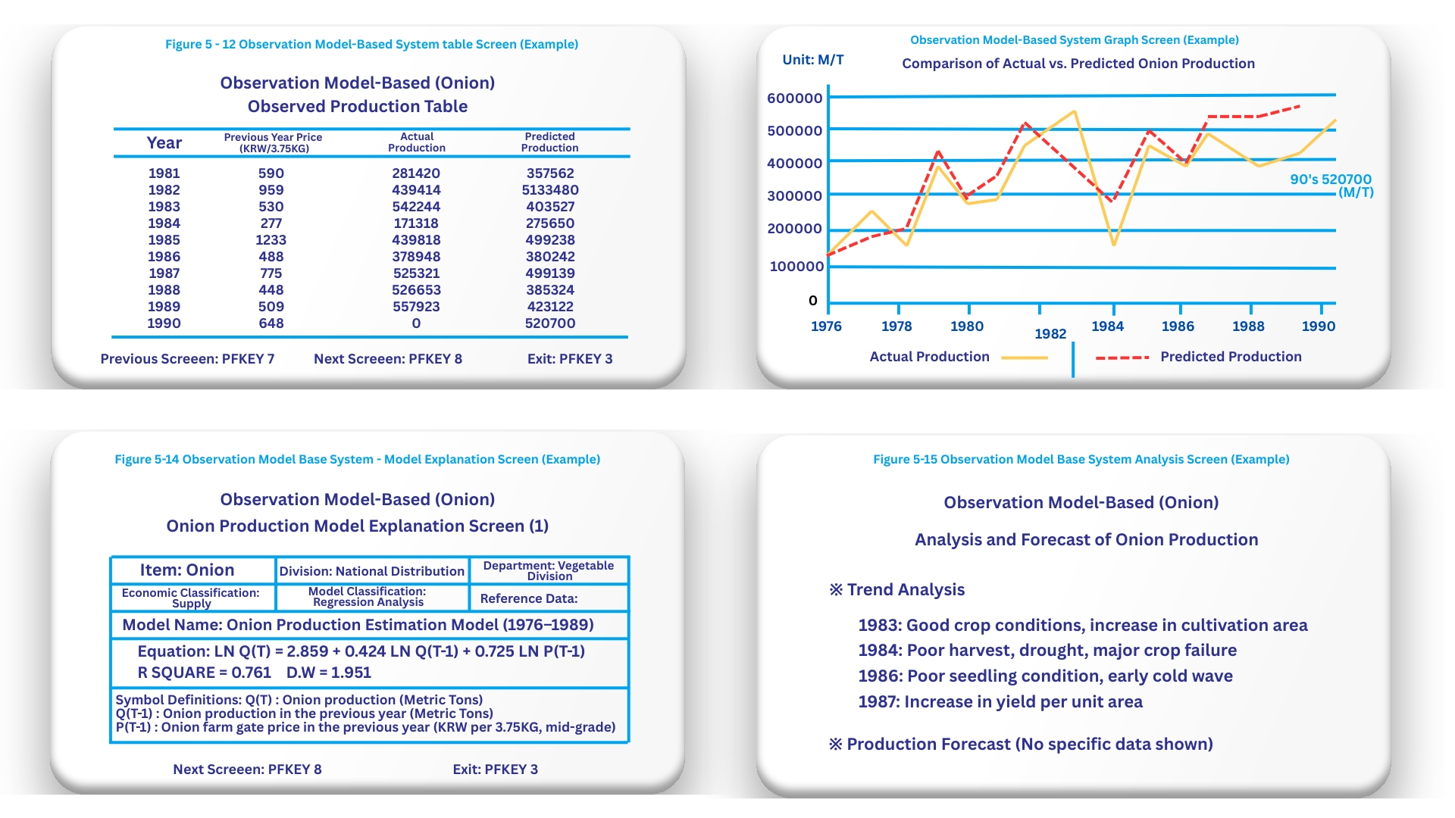
Important Research and Development Cases Related to KAIS (Agricultural Decision Support System)
What lessons will we take from failure?
Continuous management and maintenance of the system
Establishment of a dedicated team or appointing responsible personnel
What should we benchmark?
Early warning system(Dangerous Level)
Analysis reports on key decision-making points

Slide 33
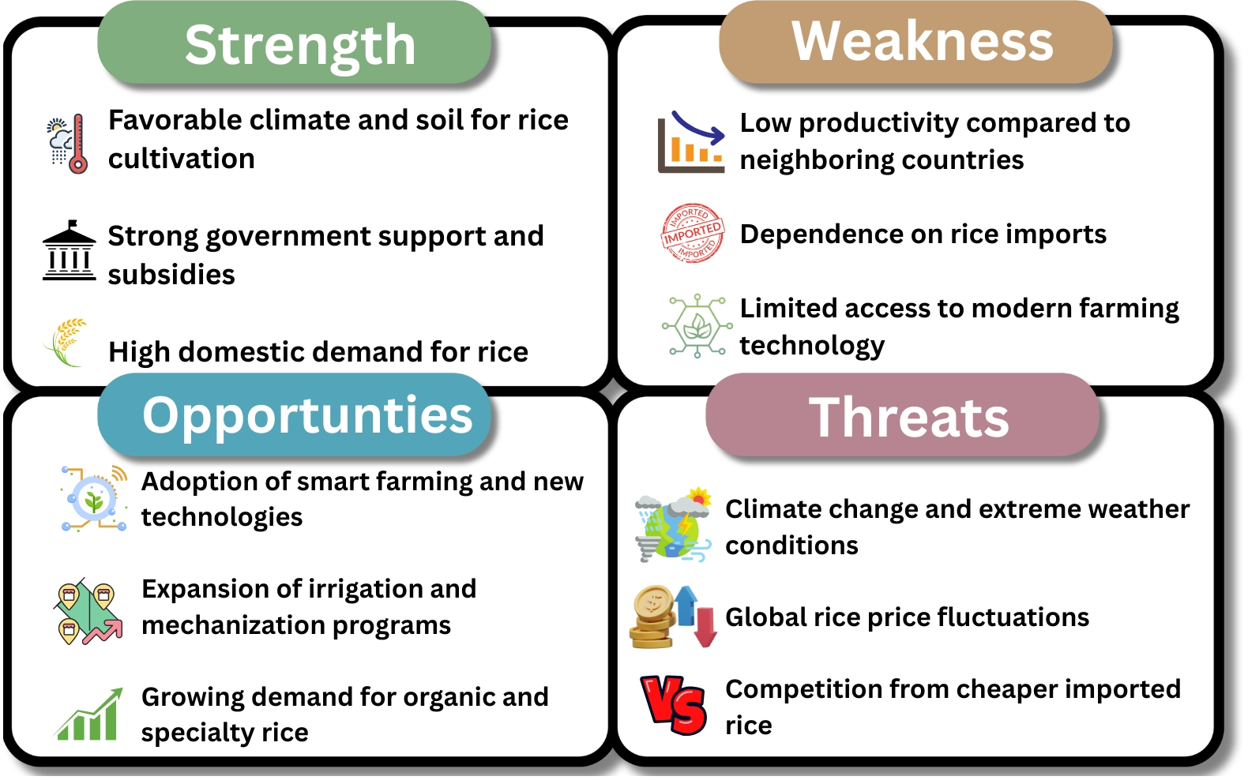
X
SWOT Analysis
of the rice industry in the Philippines
Implication and Strategic Suggestions:
Enhancing Productivity
Advancing Processing and Distribution
Policy Coordination
Promoting Digitalization

Slide 34
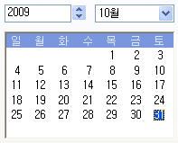
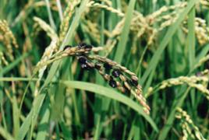
IMPORTANT RESEARCH AND DEVELOPMENT CASES RELATED TO KAIS (KOREA'S PEST CONTROL SYSTEM - IMPLEMENTATION PLAN FOR KEY TASKS - PLAN - PERSONNEL - BUDGET)
One-view system configuration -> Early warning system
Comprehensive status of pest control/prevention - Input function & Detailed view function
date :
2009/10/31
▦
Cities:
Pyeongtaek
▼
crop :
pepper
▼
classification :
condition :
request
▼
monitoring
▼
Hwaseong-si, Gyeonggi-do
Pyeongtaek-gun
Icheon-gun
Yeoju-gun
Yangpyeong-gun
Yanggu-gun, Gangwon-do
Rice plant
Chili pepper
Apple
Pear
Tangerine
Tomato
Input
Diagnostic Request
Diagnostic Assgn.
Diagnostic Intake
Notification
Control
Completion
▲
▲
▲
Monitoring
Diagnosis
Official Control
General Control
Emergency Control
Reporting
▲
Search
Enter
▼
▼
▼
▼
No. | CITY/COUNTY | CROP | CATEGORY | STATUS | DETAILS | CLIENT | HANDLER | VIEW DETAILS
1 | Pyeongtaek City, Gyeonggi Province | Pear | Monitoring | input | The stem is turning black and wilting | Hong Gil-dong
2 | Yangpyeong County, Gyeonggi Province | Tomato | Diagnosis | request | The leaves are turning yellow. | Im Kkeok-jeong
3 | Pyeongchang County, Gangwon Province | red pepper | Diagnosis | distribution | The chili peppers are rotting | Lee Su-il | im Soon-ae
4 | Hampyeong, South Jeolla Province | Rice plant | general pest control | disaster control | They are chewing on (or eating) the leaves | Romeo | Juliet
designation
of a person
in charge
looking
Assigning a
person in charge
looking
looking
looking
Initially, yellow or brown blight symptoms appear on some parts of the leaf surface, which gradually change to dark brown or black. Yellow bands are present around the lesions.
SAVE
Upload a photo

Slide 35
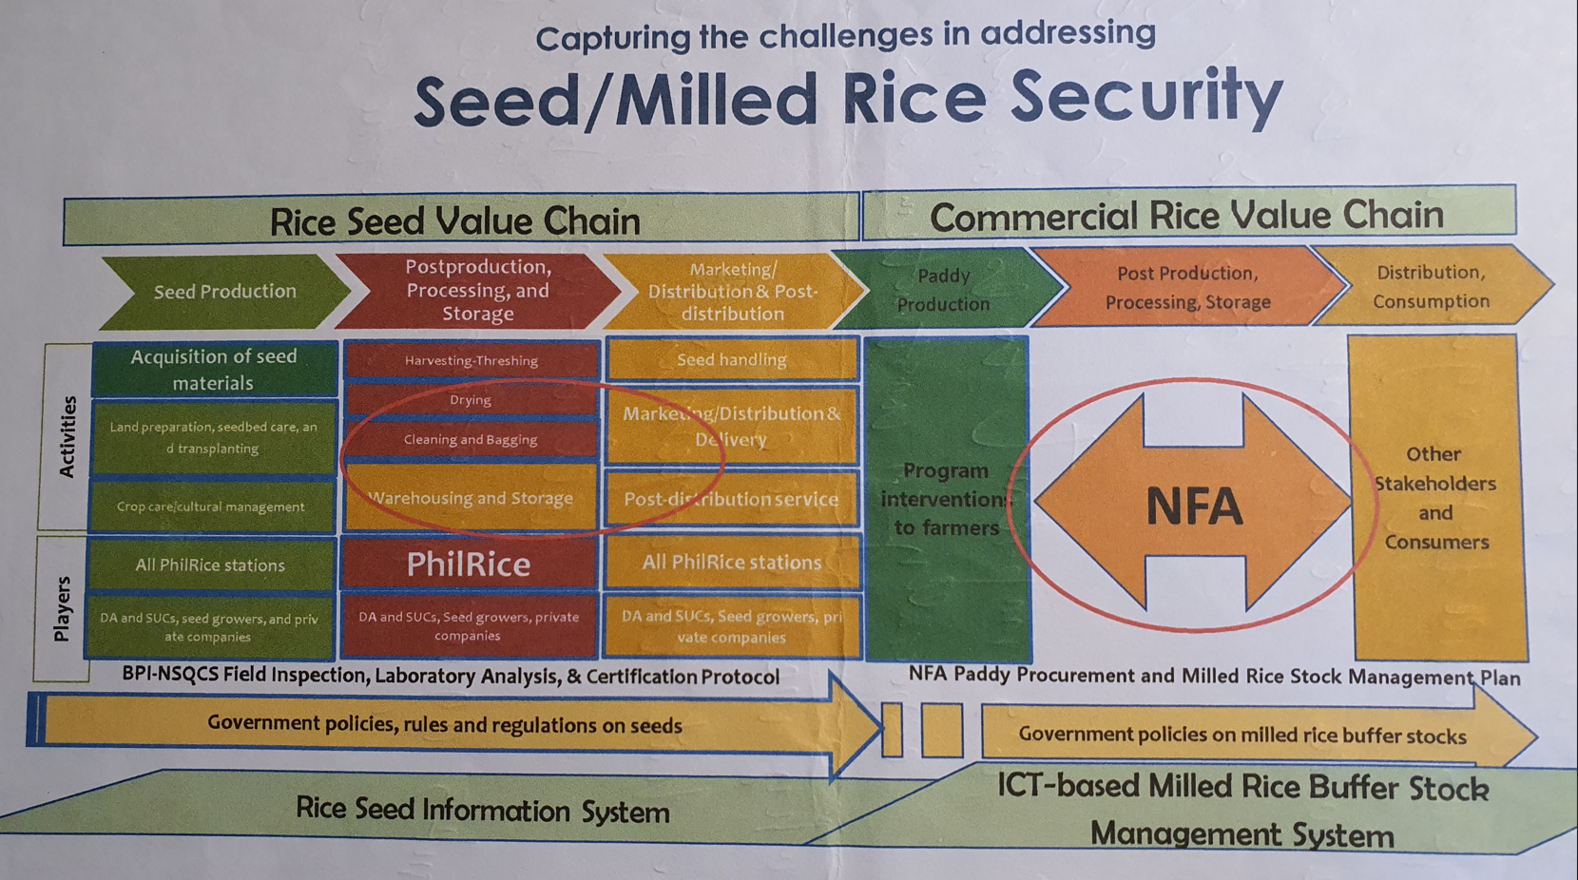
(Derivation and Improvement of Strategic Information System for the Rice Value Chain in the Philippines)
X
What should we take as a lesson from failure?
What should we benchmark?

Slide 36
Rice’s Value System
[비료산업] : 독과점
- 농업용(90%) : 남해화학
[농약산업] : 독과점
[기계산업]
수도작 대형기계수입 의존
[종자 ] : 국가 담당
보급종 갱신율(42%) 낮음
√ (-) 단수 6% 하락
[농가호수] : 903천호
[농가인구] : 153만 명
[식부면적] : 955천ha
[생산량] : 4,679천 톤
[생산액] : 8조4천억 원
[부가가치] : 6조3천억 원
- 질소 시비량(10a) 줄지 않음
√ (+) 단수 상승
√ (-) 단백질 함량 및 도복상승
- 품종 단일화↑ : 브랜드화
[RPC] : 280개소
- 건조시설 부족 및 노후화
- 건조능력대비 저장능력
농협RPC(48.5%)가 더 낮음
- 품질관리 관련 하드웨어 부족
[임도정공장] : 5천 개소
품질관리실태 Black box
[법정도매시장] : 유명무실
[대형유통업체] : 비중 낮음
소매상의 품질관리 Black box
[브랜드 관리]
- 품종 및 타 지역 쌀 혼입 발생
[혼식] : 85.2%
√ (-) 무세미 소비
낮은 이유임
[쌀 구매기준]
- 품질 : 49.0%(‘07)
41.5%(‘05)
[브랜드 인식]
- 생산지로 이해함
√ 브랜드와 생산지 구분 모호
- 쌀 브랜드 : 1,617개(‘08)
√ 광역브랜드 : 전체의 6%
Infrastructure
1. Quality Enhancement
[비료산업] : Black box
[농약산업]
- 매출액 대비 R&D 낮음
- 수입원재의 복제의존
[기계산업]
수도작 대형기계수입 의존
- 업체간 중복투자
[종자] : 고품질 고단수
진흥청(기본식물) →
기술원(원원종) →
종자관리소(원종) →
계약재배(증식포) → 보급
[고품질 쌀의 개념]
- 쌀알이 맑고, 균일하며
밥맛이 좋으면서, 영양가와
도정률이 높고 안전한 쌀
- 식미 테스트(혼식 고려X)
[최적재배기술]
- 미정착 단계
- 연구가 문제인지 보급이
문제인지 점검 필요
√ 이론적 단수 대비 12.7%↓
√ 재배면적 상위 10대 품종
육성연도 최근임(일본대비)
[국가기관]
- 농촌진흥청 농업공학부
- 한국식품연구원
[민간]
- 일본 기계의 COPY
√ (-)국내 실정에 맞는지 미지수
[민간주도]
- 밥솥, 쌀통 등
R&D
[고품질 쌀 관련 투입재
부문 정책 부재]
- 투입재 산업 자체의
경쟁력 향상(수출)에
포커스
[품질고급화]
- 고품질 안정생산기술 정착
√ 재배기술 개선
√ 표준 매뉴얼 보급
√ 맞춤형 교육과정 제공
[조직화] : 농가간 생산성차 해소
- 고품질 쌀 최적경영체 육성
√ 전체 면적의 50% 담당(‘14)
√ 들녘내 벼 재배농가 중심(2백)
* 주요 25품목 농수산물
생산∙유통구조개선대책
[고품질쌀 유통 활성화 사업]
- 시군단위 대표 브랜드
100개 육성(‘13)
- 대표 브랜드 쌀 유통
비중 50%(‘13)
[RPC 경영개선]
- RPC 규모화(시군당 2개 RPC)
√ 읍면단위 → 시군단위
√ 소비지 지향 전략 전환
시설현대화 : 저온건조∙저장
수탁판매 활성화
[브랜드 마케팅 강화]
- 브랜드 광역화
√ 시군단위 → 브랜드 광역화
√ 광역브랜드 → 지역대표 브랜드
- 브랜드 마케팅 지원 강화
√ 공동브랜드에 우선 지원
√ 도별, 국가대표 모델구축
As-Is
Policies and
Administrative Measure
2. Promotion of processing
3. Minimization of Cost
*. The idea of a strategic value chain was adopted
And researched for2years
Input
Production
Distribution
Consumption

Slide 37
Rice Value Chain
of
Korea
Revision of the Concept of High-Quality Rice and Setting the Direction for R&D
1
Households Not Eating Mixed Grains : 28% (2005) → 15% (2007)
Proportion of Households Using 2–4 Types of Mixed Grains: 78%
When Eating Mixed Grains, → Requires analysis by consumer group
1. High Quality Improvement
Indirect control of nitrogen fertilization rather than direct control
2
Increase the Renewal Rate of Certified Seed Varieties
Dissemination of Optimal Cultivation Techniques: ~ township levels
3
Study on the Optimal Location and Scale of RPC
Rising Importance of Brand : Aim for Variety Uniformity
→ Large volumes will be concentrated at the RPC all at once
→ Can the current RPC location and scale handle this volume?
To-Be
Issue of Mixing Rice from Other Regions: Improvement of Marketing Methods
4
From a method of selling a certain quantity throughout the year
→ only be purchased at specific times
Ensure uniform quality
2. Processing Activation
3. Cost Minimization

Slide 38
"Strawberry Cultivation Value Chain (As-Is)"
X
Farm
Management
Plan
Most agricultural producers are small-scale and marginal.
It is difficult to attract talent with planning and strategic capabilities.
Support sector
HR training
Production technology training
R&D
Technology Development by Input Manufacturers
Technology Transfer
Production Technology Research by Institutions like the Rural Development Administration (RDA)
Technology Transfer
Development of Agricultural Product Grading and Packaging Technology
Technology Transfer
Development of Freshness Management Technology for Distribution and Storage
Margin
Procurement
Procurement and Government Support through the National Agricultural Cooperative Federation (NongHyup)
Self-employment Model
Import of seeds and seedlings from Japan
Procurement from Packaging Container Manufacturers
Lack of Professional Design
Inputs
Production
Sorting and
Processing
Shipment and Distribution
Fertilizer
Pesticides
Agricultural Machinery
Farm Facilities
Labor
Lanc, Etc.
Production Capacity
Location/Site
Quality Control
Packaging
Brand Management
Design
Price
Distribution Channel
Inventory Management
Storage Management
Transportation Management
Primary activities

Slide 39
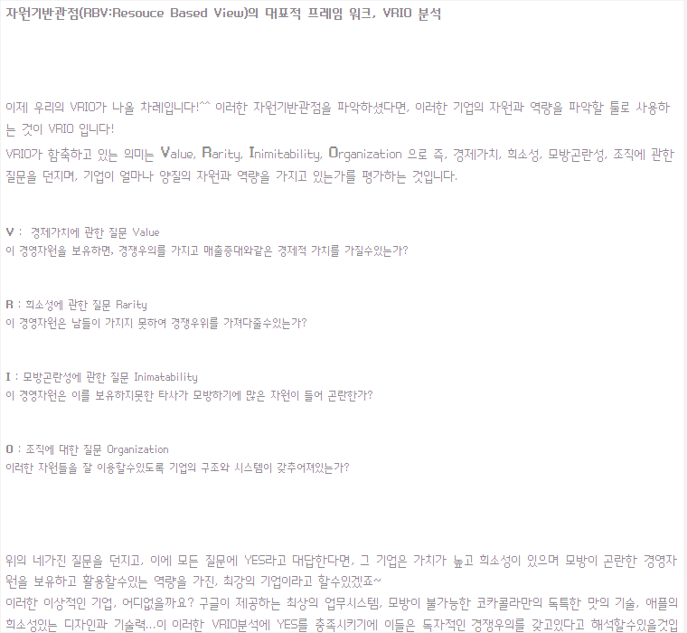
Strawberry Cultivation Value Chain (To-Be) Expanded Using the VRIO
<Value, Rarity, Inimitability, Organization> Model
Farm
Management
Plan
Planning support services for small-scale agricultural producers by region
Planning and management at the regional level
Support Sector
HR Training
In addition to production technology, strengthening education as a manager and organizational management capabilities following agricultural corporatization.
R&D
Technology development of input material manufacturers and technology transfer.
Development of domestic crop varieties and enhancement of new quality traits.
Development and transfer of technologies for sorting and packaging agricultural products.
Development of technologies enabling long-term preservation.
Margin
Procurement
Procurement through agricultural cooperatives / government support, and self-employment model.
Application of domestically produced seeds and planting materials.
Procurement of packaging materials.
Procurement of packaging and design orders aligned with marketing strategies.
Development of new quality
Valuable and scarce
Sustained competitiveness
Inputs
Production
Sorting and
Processing
Marketing
Shipment and
distribution
Service
Fertilizer
Pesticides
Agriculture Machinery
Farm Facilities
Labor
Land, etc.
Production Capacity
Location/ Site
Price
Advertising/ Promotion
Packaging
Brand
Design
Price
Distribution Channel
Inventory Management
Storage Management
Transportation Management
Quality Assurance
Speed
Sales & Service Management, Etc.
Quality management
Packaging technology
Valuable but imitable
Temporary competitive advantage
Primary activities
Import-substitution marketing
- Marketing that is valuable and organized
Achieving import substitution effects through temporary but sustained activities
What should be benchmarked?
Using the VRIO strategic model

Slide 40
Strawberry Production Application Evaluation Matrix Aligned with Marketing, Service, and Planning Strategies.
Application Evaluation Matrix for Strawberry Production
Type | CSF Application | Weight | Production | Sorting and processing | Marketing | Shipment and Distribution | Customer service
Differentiation | Quality differentiation | 1(3) | 3 | 3 | 3 | 3 | 3
 | Operational differentiation | 1(3) | 2 | 3 | 1 | 3 | 3
 | Brand differentiation | 1(3) | 2 | 3 | 3 | 3 | 3
Centralization | Quality Management | 1(3) | 3 | 3 | 3 | 3 | 3
 | Brand management | 1(3) | 2 | 3 | 3 | 3 | 3
 | Niche market | 1(2) | 0 | 1 | 3 | 2 | 2
Cost advantage | Distribution streamlining | 1(2) | 0 | 2 | 1 | 3 | 1
 | Development of automation systems | 1(1) | 2 | 3 | 0 | 2 | 0
Total |  |  | 14 | 21 | 17 | 22 | 18
Weight(0-3): 0 - No contribution, 1 - Low contribution, 2 - Moderate contribution, 3 - High contribution
As a result of differentiation, centralization, and cost leadership strategies oriented toward marketing, service, and
planning, it is judged that shipment and distribution hold high importance.
What should be benchmarked?
- Application of M. Porter's competitive strategy advantage.

Slide 41
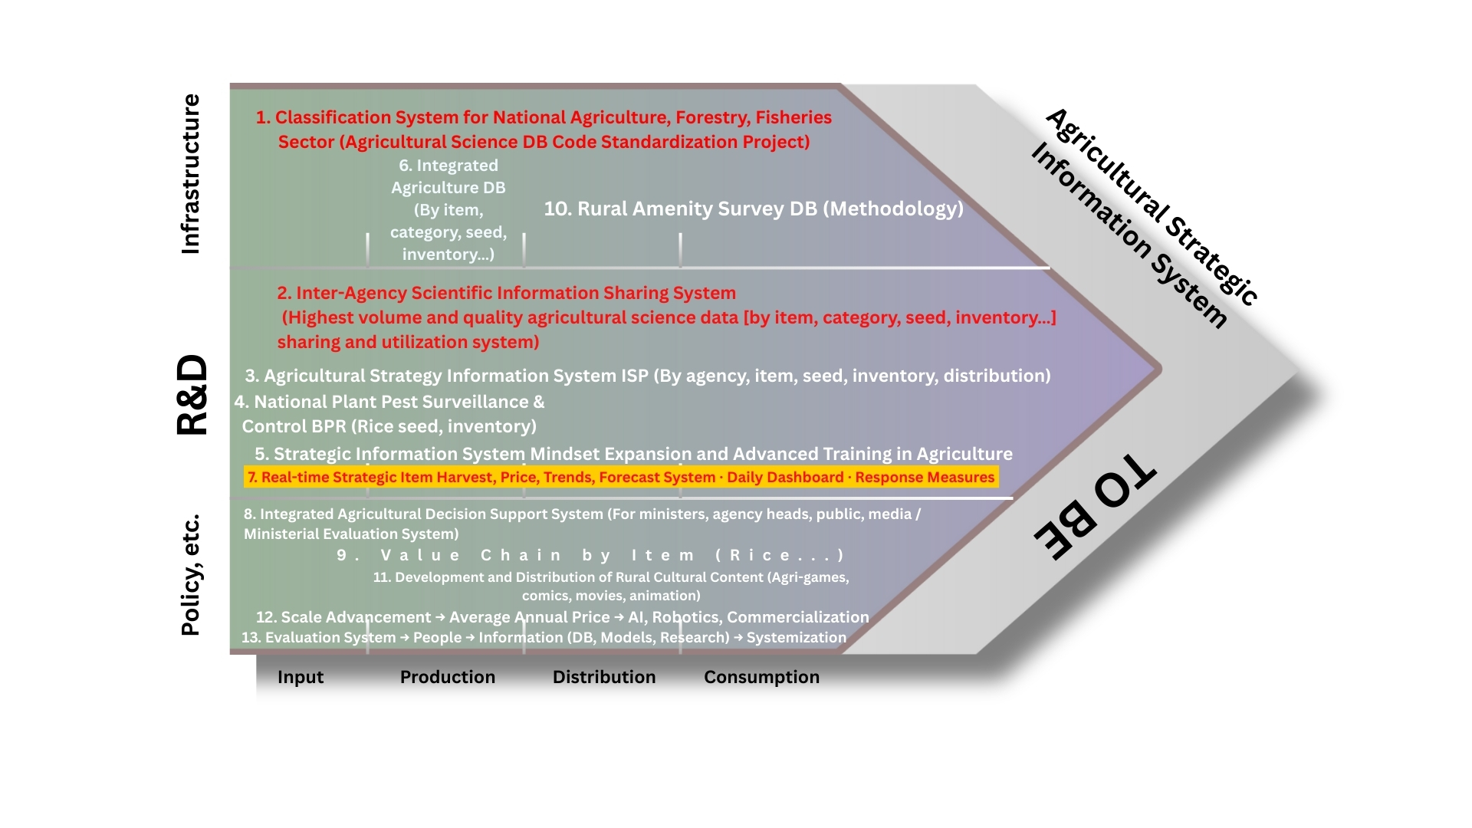
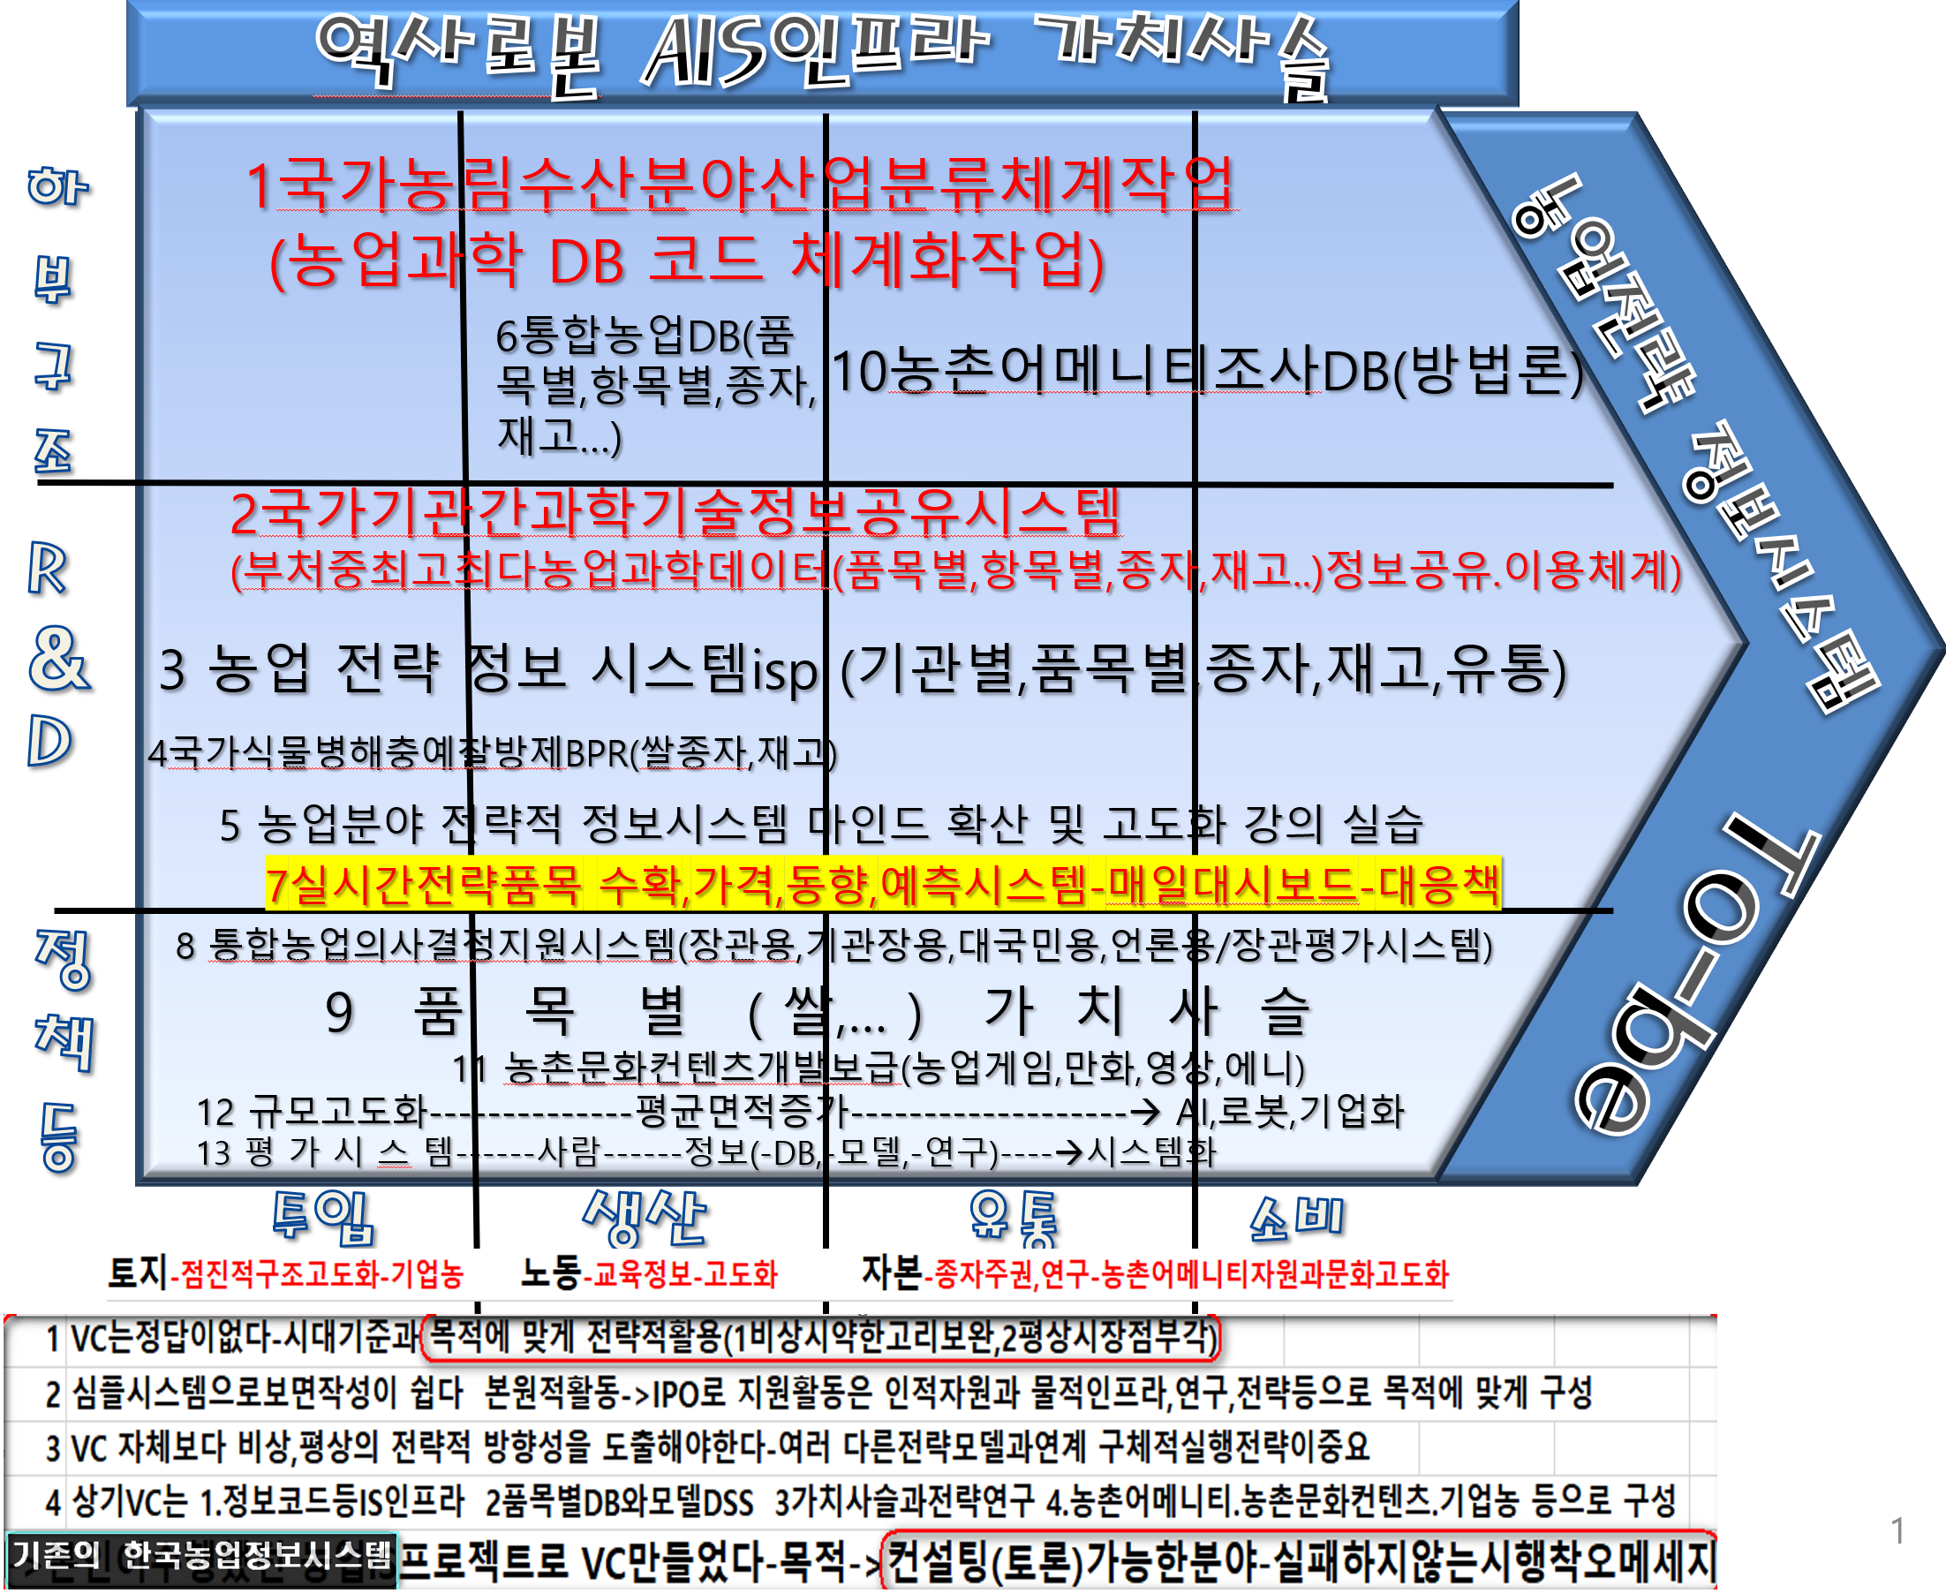
Benchmarking
K-AIS research VC
(Nolan Stage2-3?)
->future Research
Land: Gradual structural advancement
Labor: Education information
Capital: Seed sovereignty, research etc.
1 | There is no absolute answer in VC. Use it strategically based on the era and purpose
2 | Support activities should be structured to fit the purpose with human resources, physical infrastructure, research, and strategy.
3 | Strategic direction for both emergencies and normal times is more important than the VC itself.
4 | The above VC consists of: Information code IS infrastructure, Item-specific DB and DSS models, Value chain and strategy research,Rural amenities, rural cultural content, agribusiness, etc.
 | The existing Korean agricultural information system was used to build the VC project –Purpose → Identifying areas suitable for consulting (discussion) –A message about trial-and-error that doesn’t fail

Slide 42
One of the key issues of IS by Country
1
ONE OF THE KEY ISSUES OF IS BY COUNTRY
- The level of Information System Skill (Technology) in each Country is Mostly Similar
- The Difference is in the Information System
One of the key issues of IS by Country
CONSULTING TREND AND OUR DIRECTION
2
KOREA
PHILIPPINES
COMMENT
CONSULTING FOCUS
SKILL
(TECHNOLOGY)
High Group
High Group
Philippine is Better(IS English)
X(Up to staff)
Best Group
Best Group(comparing economy)
Korea is Better(IS Method,Mind)
0(Up to boss 1)
SYSTEM
One of the key issues of IS by Country
3
INFORMATION SYSTEM CRITICAL KEY POINT – CSF – Up to Boss
- How to Manage Information System (Skill (Techniques) -> System)
- How to Deal Data -> Information -> Knowledge
- How to Organize Them

Slide 43
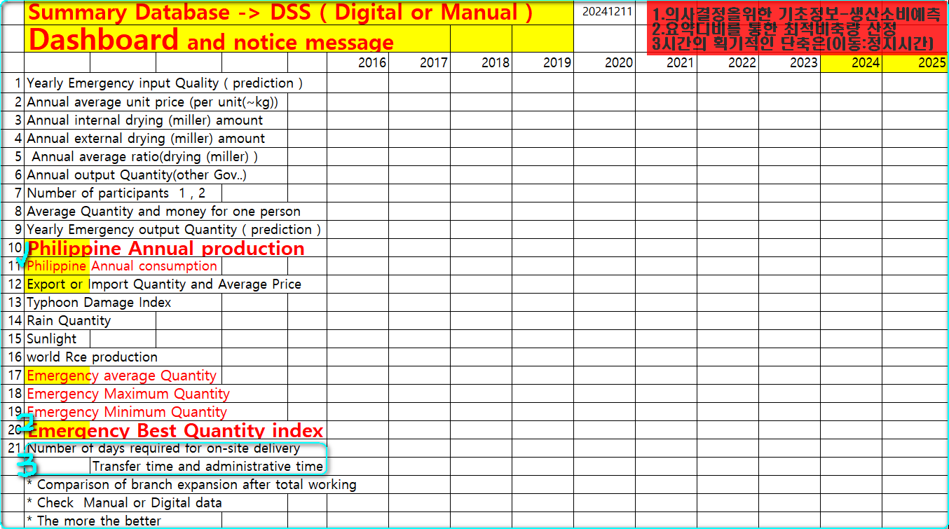

Slide 44
RICE Quantity (sample not accurate)GRAPH
LEVEL
Local Rice
(Good Quality)
LEVEL: HIGH
LEVEL: MID
Imported Rice
(Poor quality)
Because of the Rice Tariffication Law The rice stock drops at the lowest
LEVEL: LOW
1990
2000
2010
2019-20
2024-25
YEARS

Slide 45
PALAY Buffer stock (sample not accurate)GRAPH
OUTPUT
LEVEL
INPUT
LEVEL: HIGH
Buffer stock amount
LEVEL: MID
Price ?
LEVEL: LOW
0 1 2 3 4 5 6 7 8 9 10 11 12
MONTHS
HARVEST MONTHS
LEAD/TYPHOON MONTHS

Slide 46


